Slide 1
Human nutrition
Lec ..1.
Introduction To Human Nutrition P.H. 351
Dr .Banan Awawdeh

Slide 2
Objectives of this lecture.:
Define nutrition and its importance.
Define the essential nutrients.
Review the Human Body Composition.
Review the major group of foods.
Understand the Chemical Composition of food.
Review some nutritional disorder and nutritional status.

Slide 3
What is Nutrition
Nutrition is the science of how food nourishes the body.
Nutrition is based on food requirements of humans for:
energy.
growth.
maintenance.
reproduction, and lactation.

Slide 4
Nutrients
Nutrients: Chemical substances that the body uses from consumed foods.
It includes:
Water
Macronutrients—carbohydrates, proteins, fats
Micronutrients—vitamins and minerals
Nonessential nutrients → body is able to synthesize.

Slide 5
Essential nutrients
It is chemical substances found in food that cannot be synthesized at all or in sufficient amount in the body and necessary for life, growth and tissue repair.
Water is the most important nutrient for survival.

Slide 6
Good nutrition contributes to
good health
prevention of chronic conditions and diseases
energy needs
sense of well-being
Malnutrition → excess, deficiencies, or imbalance of nutrients

Slide 7
Why is nutrition important?
Why is nutrition important?
Nutrition is essential for:
growth.
Development.
health and wellbeing.
Eating a healthy diet contributes to preventing future illness and improving quality and length of life.
nutritional status is the state of your health as determined by what you eat.

Slide 8
Undernutrition and Overnutrition
Undernutrition:
Results from insufficient intake or low body stores
Causes: Poor wound healing, loss of muscle mass, functional decline, altered immune status, growth faltering
Overnutrition:
Results from intake or stores of nutrients in excess
Causes : Obesity, hypercholesterolemia, and toxic levels of stored vitamins

Slide 9
Nutritional needs based on:
Life stage
Health-illness considerations
Cultural and religious preferences
Genetic influences
Good nutrition = disease prevention and health promotion

Slide 10
Health care team
Participate in initiatives focused on prevention of health problems.
Educate clients about the benefits of nutritional diets.
Advocate for the nutritional needs of clients.
Develop nutritionally balanced diet plans for clients

Slide 11
The Steps Nutritional Care include:
Systematically gathering data.
Analyzing data.
Planning realistic goals.
Implementing activities to achieve goals.
Evaluating goal accomplishment.

Slide 12
Role of Registered Dietician
Completes comprehensive nutritional assessments.
Writes nutritional diagnoses.
Plans interventions.
Monitors client’s or family’s response to nutritional plan.

Slide 13
Assessment
Client history.
Anthropometric data.
Laboratory data.
Client’s physical activity level.
Taking in to consideration:
Client’s sociocultural beliefs.
Client’s religious beliefs.
Cooperation between health care providers and dietician → seamless, holistic nutritional care

Slide 14
Dietary Intake Records
24-hour recall.
Food diary
Food frequency questionnaire.
Data about:
Timing and location of food consumption.
Emotional state when consumed.

Slide 15
Nutritional Screening
Screening: version of an assessment that may trigger the need for a more thorough assessment.
Screening quickly identifies individuals at risk for poor nutritional health.

Slide 16
Nutritional Screening
Checklist or instrument used to provide rapid, quantifiable data.
Variety of instruments are available for different age groups.
Important in acute care setting due to impact of nutrition status on medical outcome.

Slide 17
Nutritional Assessment:
An assessment provides more in-depth data than does a screening.

Slide 18
Studies of nutritional status
This include measurements of :
***anthropometric indicators
***biochemical indicators
***clinical indicators

Slide 19
anthropometric indicators
The measurement commonly used are
height and weight:
These can be used to calculate the body
mass index(BMI)
In children height and weight results can be compared with standard growth curves which indicate the physical development of child.

Slide 20
Anthropometric Data
Height.
Weight.
Skinfold and circumference measurements.

Slide 21
Body Mass Index (BMI)
An assessment of relative height for weight, expressed as:
BMI = weight (kg) / height (m)2.
Example : weight=100kg
Height=150cm
Calculate BMI?

Slide 22
BMI Continue……
BMI is used to classify client as underweight, healthy weight, overweight, or obese.
Taking into consideration:
Frame size or body composition.
Muscle mass.
Alternative measures to determine height of clients with disabilities that make it difficult to stand straight

Slide 23
Methods of determining body composition and fat distribution:
Skinfold measurements.
Circumference measurements.

Slide 24
Waist-to-hip ratio: divide waist measurement by hip measurement:
“Apple” body type: ratio close to or exceeding 1.0
“Pear” body type: ratio below 0.8.
Ideal Waist Circumference:
Men: 35 inches or less
Women: 30 inches or less

Slide 25
Physical signs of nutritional status
Oral Cavity:
o Healthy gums.
o Presence or absence of teeth.
o Condition of teeth.
o Smooth red tongue.
• Smoothness of lips.
• Curvature of spine.
• Smoothness and shininess of hair and nails.

Slide 26
biochemical indicators
It include assessment of blood and urine samples for level of variety of nutrients or nutrients linked enzyme activities.
Analysis may be performed on samples of hair or bon marrow.

Slide 27
biochemical indicators….CONT
Analysis to blood can be used to determine:
**the actual level of nutrients in relation to expected level such as vitamin B 12, folate, vitamin C in white blood cell.

Slide 28
biochemical indicators….CONT
Urine samples may be used to monitor the baseline excretion of water soluble nutrients .
Metabolites of nutrients also appear in the
Urine and their levels can be monitored.
24 hour urine collection can be assayed for creatinine to indicate muscle turnover rates or nitrogen content to check protein intake.

Slide 29
Laboratory Value:
Each laboratory value = only part of the complete assessment data

Slide 30
clinical indicators
clinical indicators can be used to detect changes in the external appearance of the body number of nutritional deficiencies may cause alteration in superficial structures….changes hair, skin….

Slide 31
Dietary Reference Intakes (DRIs)
Dietary Reference Intakes (DRIs) recommendations:
Outlined by age and gender
Change with new research findings

Slide 32
Dietary Guidelines for Americans promote diet and physical activity to:
Achieve health.
Reduce risk of chronic disease.

Slide 33
What can we learn from nutritional assessment.
The previous techniques can be used to obtain more detailed picture of the dietary intake and nutritional status of population.
Many countries such as USA, Canada,…and others by using surveillance to monitor both what people are eating and the effects of diet on disease.

Slide 34
The Human Body Composition
■ The Human Body Composition
Reference Chemical Composition
Compartment Man (70kg) Woman (60kg)
• Fat 13% 25 %
(in normal newborns) (14 %) (14 %)
(at age 8 months) (26%) (26%)
(at age 1 year) (22 %) (22 %)
(at onset of adolescence) (16 %) (16 %)

Slide 35
■ The Human Body Composition
Reference Chemical Composition
Compartment Man (70kg) Woman (60kg)
• Proteins 20% 18 %
• Minerals 6% 6 %
• Water 60% 50 %
• CHO & Others 1% 1 %
• fat 13% 25%

Slide 36
Major Groups of Foods
The Natural Containers of Nutrients

Slide 37
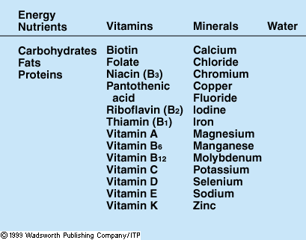
Nutrients : Summary Table
JUST
Notes:
“essential” nutrients are req’d in diet; “nonessential” nutrients are in food and used by body but not req’d in diet b/c body can produce them. Examples: cholest, vit C in most animals. Amt of essential nutrients needed varies from micrograms to kg.

Slide 38
MyPyramid
It promotes individualized approach to physical activity and dietary planning.
Pictorial guide provides daily food recommendations.
Encourages intake from all food groups.
Encourages moderation in diet habits.
Provides personalized recommendations.

Slide 39
4. Nutrition Facts Food Label includes:
Food amount and calorie content.
Macronutrient content.
Micronutrient content.
Daily Reference Values.

Slide 40
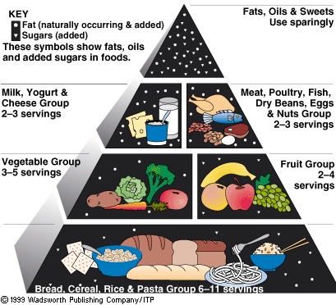
Food Guide Pyramid
……

Slide 41
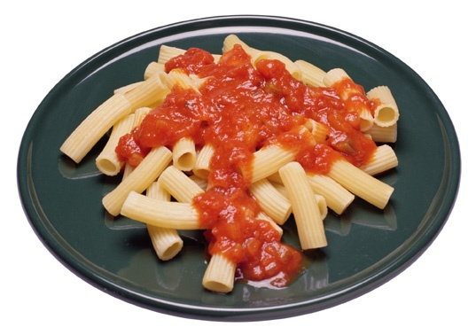
Cereals / Energy and Fibers

Slide 42
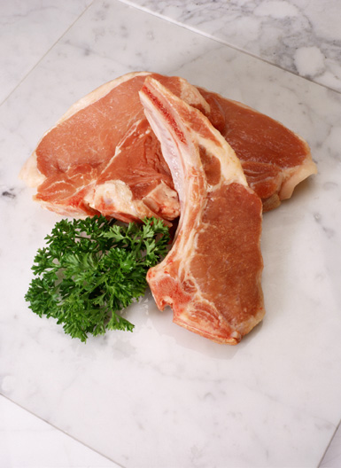
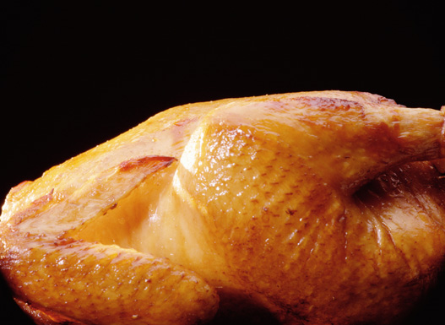
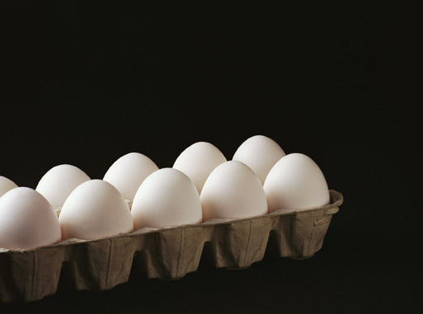
Meat / Protein & Trace Minerals

Slide 43
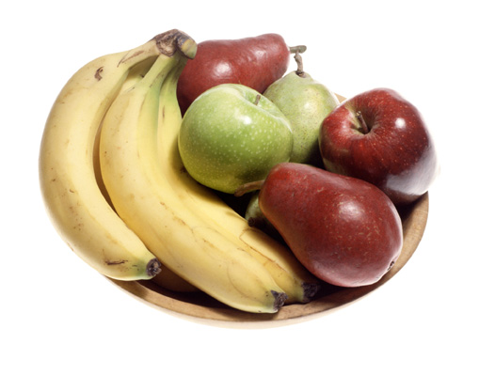
Fruit / Vitamins C and A

Slide 44
Empty Calories The Auxiliary Group: Sweets & Fats

Slide 45
Nutritional Disorders
OverNutrition: (most commonly linked to affluence).
- A state resulting from a dietary - positive energy balance of individuals; clinically, it is overweigh
- by using the formula BMI (body mass index) = weight (kg) / height² (m).
Ex(88/1.65*1.65= 32 as BMI)

Slide 46
Nutritional Disorders
Cont..OverNutrition: (most commonly linked to affluence).
- Normal range for adults BMI = 20-25 kg /m². Adolescents and children have different cut-off points.

Slide 47
BMI Assessment and Recommended Weight Gain
Recommend Weight Gain During Pregnancy | Assessment of Weight | BMI
12.5-18 kg | Underweight | Less than 18.5
11.5-16 kg | Normal weight | 18.5-24.0
7.0-11.5 kg | Overweight | 24.0 and above

Slide 48
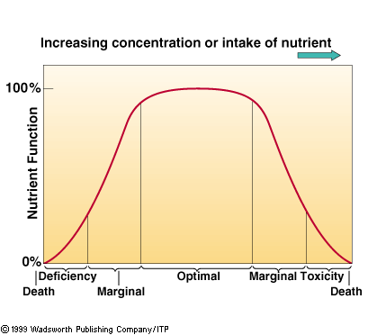
Poor Nutrition
Intake→ Inadequate Adequate Excess
Notes:
Text example of how vit A deficiency develops

Slide 49
Major nutritional-health disorders
Classical listing: malnutrition, anemia, obesity, rickets…..
Recent addition: diabetes mellitus, cardio vascular disease, renal disease, liver disease, gout, food-allergies…..

Slide 50
UnderNutrition : (most commonly linked to poverty).
- Results from the ‘considerable inadequacy’ of nutrient(s)’ supply to target tissues.
- Types:
1) Pan-Malnutrition [commonly known as “malnutrition” ,or “protein-energy-malnutrition,
2) Deficiency - conditions : pertain only to any of the micronutrients, and to the essential fatty acids(EFAs)’, inadequacies.

Slide 51
Malnutrition
Malnutrition refers to insufficient, excessive, or imbalanced consumption of nutrients. In developed countries, the diseases of malnutrition are most often associated with nutritional imbalances or excessive consumption.

Slide 52
Eating Disorder
An is a compulsion to eat, or avoid eating, that negatively affects both one's physical and mental health. Eating disorders are all encompassing. They affect every part of the person's life.

Slide 53
Cont.. Eating Disorder
Eating disorders are serious mental illnesses; cause serious physical problems and can even be life-threatening. Most people with eating disorders are females, but males can also have eating disorders..’
It is “feelings about work, school, relationships, day-to-day activities” examples Anorexia nervosa and bulimia nervosa are the most common.

Slide 54
Undernutrition: a global challenge
Under nutrition is the most common health problem.
Even in the milder form it can weaken the immune system.

Slide 55
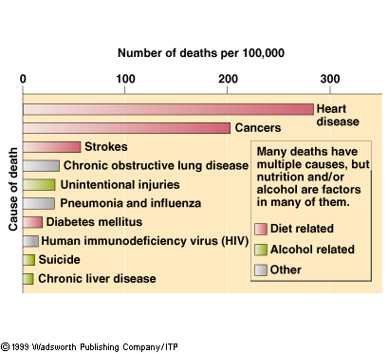
Nutrition & Chronic Diseases
Mortality Rates
Notes:
Concept #8: poor nutr can influence the development of certain chronic diseases

Slide 56
The influences on eating habits
Think…….. Why you eat.
***physiological need.
***habit.
***social influence.

Slide 57
CONT……brain and eating
You may think that hunger is all in your stomach and that dieting is all in your head. But nutrition experts know that hunger is regulated by a complex system of chemicals that send signals between your brain and your body.
The cells in the hypothalamus communicate with cells in other parts of the brain to coordinate the release and uptake of chemicals that help regulate how much and what you eat.

Slide 58
Cont..Nutritional Energy
■ The Dietary Pyramid (the 4 Basic Food Groups)
I. Milk and dairy products [cups]
II. Meats (or equivalents) [grams]
III. Fruits (F) &Vegetables (V) [cups]
IV. Bread (Cereals) [grams]

Slide 59
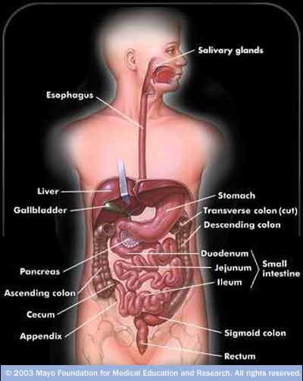
The GIT
JUST-Faculty of Medicine

Slide 60
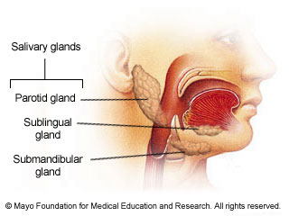
Mechanical Digestion
Department of community Medicine - Faculty of Medicine - Jordan University of Science and Technology (JUST)

Slide 61
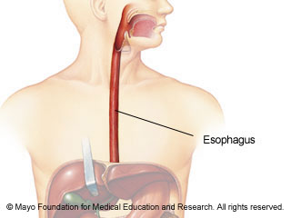
Mechanical Digestion
Department of community Medicine - Faculty of Medicine - Jordan University of Science and Technology (JUST)

Slide 62
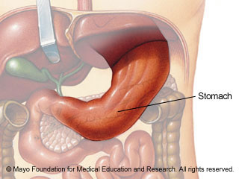
Mechanical Digestion
Department of community Medicine - Faculty of Medicine - Jordan University of Science and Technology (JUST)

Slide 63
Mechanical Digestion
Department of community Medicine - Faculty of Medicine - Jordan University of Science and Technology (JUST)

Slide 64
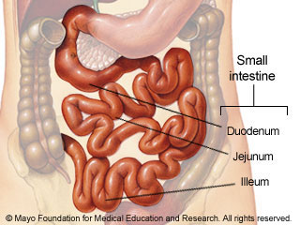
Chemical Digestion
Department of community Medicine - Faculty of Medicine - Jordan University of Science and Technology (JUST)

Slide 65
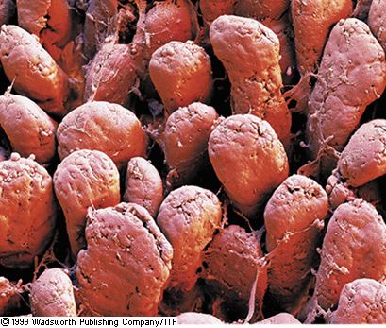
Villi of the Small Intestine…...
where most absorption takes place

Slide 66
Digestion & Absorption
General Features
■ Macronutrients enter circulation only after food undergoes:
- mechanical digestion (modification of food consistency to render it fluid), &
- chemical digestion (hydrolysis of glycoside, glceride, and peptide linkages).

Slide 67
Cont..Digestion & Absorption
Cont..General Features
■ Practically, all chemical digestion and absorption of nutrients occur at the small intestines.
■ Some water is absorbed at the small intestines.
At the colon, most of the water and some vitamin K are absorbed.
■ At duedenum, pancreatic digestive enzymes and bile meet and mix with the Chylos. Digestion pathways are:

Slide 68
If food is Not Digested and absorbed
This food will not undergo absorption
It will be eliminated in the feces (stool)
It will not provide nutrients.

Slide 69
Questions ???????

