Slide 1
Oncology: Nursing Management in Cancer Care

Slide 2
Cancer
A disease process that begins when an abnormal cell is transformed by the genetic mutation of cellular DNA
The abnormal cells have invasive characteristics and infiltrate other tissues. This phenomenon is metastasis.
Cancer cells are described as malignant. These cells demonstrate uncontrolled growth that does not follow physiologic demand.

Slide 3
Malignant Process
Cell proliferation: uncontrolled growth, with the ability to metastasize and destroy tissue and cause death
Cell characteristics: presence of tumor-specific antigens, altered shape, structure, and metabolism
Metastasis:
Lymphatic spread
Hematogenous spread
Angiogenesis
Carcinogenesis

Slide 4
Carcinogenic Agents and Factors
Viruses and bacteria
Physical factors: sunlight, radiation, chronic irritation
Chemical agents: tobacco, asbestos
Genetic and familial factors
Diet
Hormones
Role of the immune system

Slide 5
Early Warning Signs for Cancer
Cancer 7 early warning signs ( CAUTION )
Change in bowel or bladder habits.
A sore that does not heal.
Unusual bleeding or discharge.
Thickening or lump in breast or scrotum.
Indigestion or difficulty in swallowing
Obvious change in a mole or wart.
Nagging cough or hoarseness.

Slide 6
Primary and Secondary Prevention
Primary prevention is concerned with reducing cancer risk in healthy people.
Secondary prevention involves detection and screening to achieve early diagnosis and intervention.
There is now great emphasis on the primary and secondary prevention of cancer.

Slide 7
Primary Prevention
Avoid known carcinogens.
Lifestyle and dietary changes to reduce cancer risk
Public and patient education
See Chart 16-2.

Slide 8
Secondary Prevention
Identification of patients at high cancer risk
Cancer screening
Self-breast exam
Self-testicular exam
Screening colonoscopy
Pap test
Public and patient education

Slide 9
Diagnosis of Cancer
Diagnostic Tests See Table 16-4
Tumor staging and grading See Chart 16-3 TNM classification

Slide 10
Staging: determine size of tumor and the existence of metastasis
TNM classification used:
T→ extent of primary tumor
N → lymph node involvement
M → extent of metastasis
Grading: classification of tumor cells
Used to define the type of tissue from which the tumor cell originate, and the degree to which the tumor cells retain the functional Ch.Ch of the tissue of origin
Obtained through biopsy or surgical excision
Grading from I- IV
I : well differentiated tumors, closely resemble the tissue of origin in structure and function
IV: poorly differentiated tumors, not clearly resemble the tissue of origin in structure or function

Slide 11
T = tumor size
e.g. 0 – No evidence of primary tumor
T I, II, III & IV – number allocated to size of primary tumor.
I represents smallest size, ranging up to stage IV.
N = Regional lymph node involvement
N0: tumor cells absent from regional lymph nodes
N1: tumour cells spread to closest or small number of regional lymph nodes
N2: tumor cells spread to an extent between N1 and N3.
N3: tumor cells spread to most distant or numerous regional lymph nodes
M = metastasis
M 0 – no evidence of distant metastatic spread.
M I – evidence of distant metastatic spread.

Slide 12
Cancer classification according to tissue type
Epithelial as ( adenocarcinoma)
Connective tissue as in bone ( osteosarcoma)
Hematologic ( monocytic leukemia)
Lymphatic (lymphomas)

Slide 13
Cancer Management
Cure ( complete eradication of malignant disease)
Control ( prolonged survival)
Palliation ( relief of symptoms associated with the disease especially pain)

Slide 14
Surgical Treatment
Diagnostic surgery
Biopsy: excisional, needle, incisional
Tumor removal: wide excision, local excision
Prophylactic surgery
Reconstructive surgery

Slide 15
As a primary treatment
The goal is to remove the entire tumor and any involved surrounding tissue
2 approach:
1- local excision : used when mass is small, it includes removal of the mass and a small margin of normal tissue.
2- wide (radical) excision : considered when tumor can be removed completely and the chance of cure or control is good, include removal of tumor, L.N, adjacent and surrounding tissue of high risk for tumor spread

Slide 16
Diagnostic Surgery
Used to obtain biopsy for analysis
From the tumor or from L.N near the suspicious tumor
3 types:
1- Excisional:
Used for easily accessible tumor of the skin, breast, URT, upper and lower GIT
Entire tumor with surrounding marginal tissue is removed
It helps in ↓the chance of disseminating cancer cell through surrounding tissue
Performed through endoscopy

Slide 17
2- Incisional biopsy:
Performed when tumor mass is too large to be removed
Wedge of tissue from the tumor is removed for analysis
Performed through endoscopy
3- needle biopsy:
Performed to obtain sample from suspicious mass that are easily accessible as growth in breast, thyroid, lung, liver and kidney
Fast, inexpensive, easy to perform, required local anesthesia

Slide 18
2- Incisional biopsy:
Performed when tumor mass is too large to be removed
Wedge of tissue from the tumor is removed for analysis
Performed through endoscopy
3- needle biopsy:
Performed to obtain sample from suspicious mass that are easily accessible as growth in breast, thyroid, lung, liver and kidney
Fast, inexpensive, easy to perform, required local anesthesia

Slide 19
Palliative surgery:
Used when cure is not possible
Goal: to make pt comfortable as possible and to promote a satisfying and productive life
Performed to relive complications as pain, ulceration, bleeding, effusion
E.g colostomy →when there is bowel obstruction
pleural tube placement → for pleural effusion
Reconstructive surgery:
Followed curative or radical surgery
Performed to improve function, and done in one operation or in stages
May indicated for breast, head, neck and skin cancer.

Slide 20
Nursing management in cancer surgery
Pre op assessment for factors that affect pt
Education and emotional support
Communicate frequently with Dr and other health care member to be certain that provided information is consistent
After surgery the nurse assess pt response to surgery, and monitor him for complication (infection, bleeding, thrombophlebitis, fluid and electrolyte imbalance
Teach pt about wound care, activity, nutrition and medications

Slide 21
Radiation Therapy
Curative, control, or palliative
External radiation
Internal radiation
Radiation reactions
Effect on the GI system
Effect on bone marrow
Systemic effects
Long-term effects and tissue changes

Slide 22
Radiation Therapy
It is the use of ionizing radiation to interrupt cellular growth
> 1\2 of pt with cancer receive it at some point during treatment
Used to cure thyroid carcinoma, cancer of uterine cervix, Hodgkin disease
Used to control disease when tumor cannot removed or when metastasis is present
It can used prophylacticaly to prevent leukemia infiltration to brain or spinal cord
It breaks the strand of DNA helix leading to cell death
2 types used:
1- electromagnetic rays ( X-rays & gamma rays)
2- particles ( electrons, protons, and alpha particles)
Radiation delivered to tumor by external or internal means

Slide 23
External radiation:
Uses depend on depth of the tumor
They use x-rays to destroy cancerous cells at the skin surface or deeper in the body
The higher the energy the deeper the penetration into the body
Internal radiation:
Or brachy therapy
It deliverers high dose of radiation to localized area
Can be implanted by needles, seeds, catheters into body cavities, it can administered orally
Pt contact with personnel is minimize to decrease exposure to radiation
Pt placed in private room, the staff member wear protective clothing, hr’s of visit limits to 30min\day , and 6 feet distance

Slide 24
Radiation dosage:
Depend on the target tissue sensitivity to radiation, and on the tumor size
Lethal tumor dose: is the dose that will eradicate 95% of tumor yet preserve normal tissue
It delivered over several weeks to allow healthy tissue to repair, and to achieve greater cell kill

Slide 25
Nursing Care of the Patient Undergoing Radiation Therapy
Patient and family education
Include restrictions and precautions
Skin care
Oral care
Protection of care providers

Slide 26
Toxicity from radiation therapy
The effect:
Altered skin integrity (alopecia, erythema)
Altered oral mucosa (stomatitis, xerostomia (mouth dryness, change & taste loss, decrease salivation)
Esophageal irritation with chest pain and dysphasia
Anorexia, nausea and vomiting & diarrhea
Anemia, leukopenia and thrombocytopenia
Fatigue and malaise

Slide 27
Nursing management in radiation therapy
The nurse explain the procedure for delivering radiation, describe the equipment, duration of procedure, possible need for immobilization
If implant is used the nurse informs pt and family about restrictions placed on visitors
Explain to the pt his role before, during and after procedure
Assess pt skin, nutritional status, oral mucosa for change
Pt skin protected from irritation and instructed to avoid using ointment, lotions or powder on the area
Provide oral hygiene to remove debris and promote healing
If pt feel fatigue assist him in activity of daily living
Explain that fatigue and malaise are S\E from Rx and not indicate deterioration
Explain purpose from isolating pt

Slide 28
Chemotherapy
Agents used to destroy tumor cells by interfering with cellular function and replication
Curative, control, or palliative
Used to treat systemic disease rather than localized lesion.
It administer in coordination of cell cycle
Cell cycle time: time required for one cell to divide and reproduce 2 identical daughter cells
Types of chemotherapeutic agents See Table 16-6

Slide 29
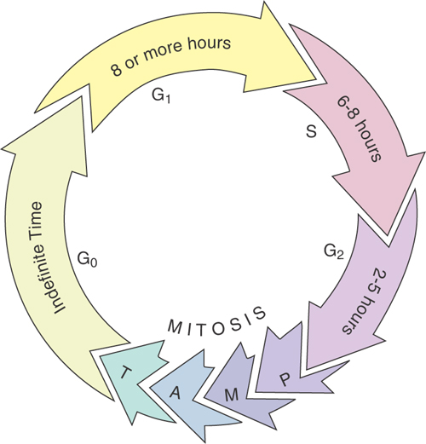
Phases of Cell Cycle

Slide 30
Classification of chemotherapy
Cell cycle specific agent( specific to certain phase of cell cycle)
Cell cycle non specific agents (act independently of cell cycle phase)
It classified by chemical group as alkalizing agents, antimetabolites, antitumor antibiotics, hormonal agent

Slide 31
Chemotherapy Roles and Chemotherapeutic Agents
Notes:
Figure 14–6 Vascular access devices. A, Single-, double-, and triple-lumen catheters. B, Single- and double-lumen Groshong catheters.

Slide 32
Administration of Chemotherapy
Routes of administration
Problem of extravasation
Increased risk for fluid and electrolyte imbalances
Risk for infection
Risk for bleeding
Protection of caregivers See Chart 16-7
See Chart 16-5

Slide 33
Adverse Effects of Chemotherapy
Toxicity
GI effects: nausea and vomiting, diarrhea, mucositis, and stomatitis
Hematopoietic effects: myelosuppression
Renal damage
Cardiopulmonary system: potential cardiac toxicities
Reproductive system: potential sterility, potential reproductive cell abnormalities
Neurologic effects

Slide 34
Bone Marrow Transplantation (BMT)
Used for hematologic cancers that affect the marrow or solid tumors, which are treated with a chemotherapy dosage that ablates the bone marrow
Graft-vs.-host disease
Venous occlusive disease

Slide 35
Nursing process for pt with cancer
Assessment:
Assess factors promote infection (chemotherapy, malnutrition, intravenous catheter, age, contaminated equipment,…)
Monitor lab test as WBC’s
Assess S&S of infection
If invasive catheter is placed assess pt for sepsis
Assess pt for factors that may contribute to bleeding as ( chemotherapy, radiation, medications as aspirin, persentein, heparin)
Monitor pt for hemorrhage, melena, hematuria, hemoptysis, hematomesis, ecchymosis, and change in mental status. sputum or vomitus

Slide 36
Assess the pt for any skin problems, note the presence of skin lesions or ulcerations, or lesions in the MM
Note presence of alopecia, and assess it’s psychological impact on the pt
Assess pt nutritional status (if there is wt loss, cachexia (muscle wasting))
Assess pt diet history, episode of anorexia, change in appetite, difficulty in swallowing, presence of N,V&D
Assess source and site of pain
Assess factors increase pt pain as fear, anger, fatigue, social isolation
Assess for chronic fatigue, and assess stressors contribute to fatigue as ( pain, dyspnea, fear, anxiety, and constipation)

Slide 37
Common Nursing Diagnoses
Impaired oral mucosa
Impaired tissue integrity
Imbalanced nutrition
Chronic pain
Fatigue
Disturbed body image
Coping diagnoses and anticipatory grief

Slide 38
Collaborative Problems
Infection
Bleeding
Superior vena cava syndrome
Hypercalcemia
Spinal cord compression
Pericardial effusion
Disseminated intravascular coagulation (DIC)

Slide 39
Hospice
Comprehensive, multidisciplinary approach to the care of patients with terminal illness and their families
Focuses upon:
Quality of life
Palliation of symptoms
Psychosocial and spiritual care

Slide 40
Oncologic Emergencies
Superior vena cava syndrome
Spinal cord compression
Pericardial effusion and cardiac tamponade
Disseminated intravascular coagulation (DIC)
Syndrome of inappropriate secretion of antidiuretic hormone
Tumor lysis syndrome

Slide 41
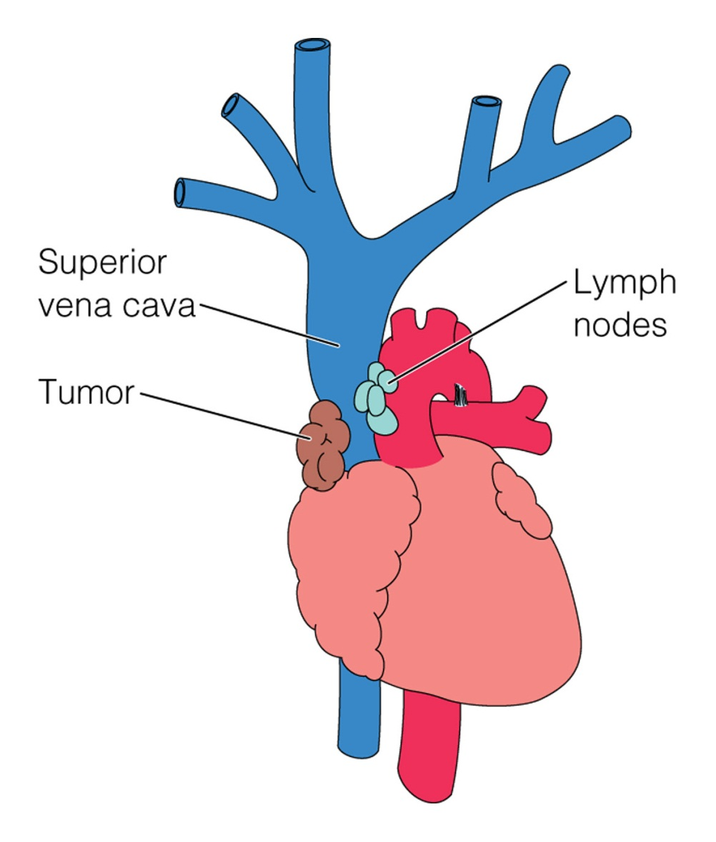
Superior Vena Cava Syndrome
Notes:
Figure 14–7 The superior vena cava syndrome. The enlargement of a tumor adjacent to the superior vena cava (usually in the lung or mediastinum) compresses that major blood vessel, which leads into the right atrium of the heart. As a result, blood backs up into the venous system behind the obstruction, diminishing blood flow into the heart.

