Slide 1
Parkinson Disease mashehabat@just.edu.jo

Slide 2
Basal Ganglia
Consist of Four Nuclei
striatum
  caudate and putamen
globus pallidus
substantia nigra
subthalamus

Slide 3
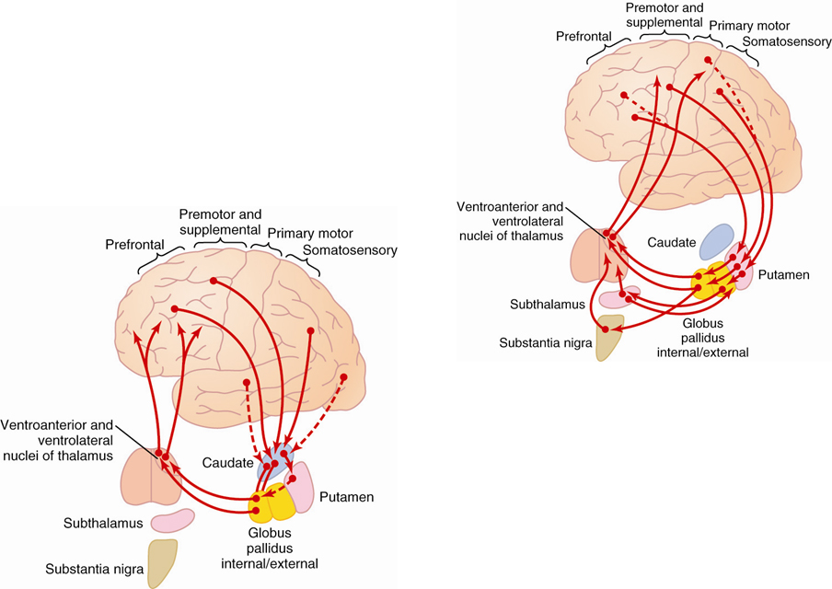
The basal ganglia are the principal subcortical components of a family of parallel circuits linking the thalamus with the cerebral cortex

Slide 4
Motor Function of the Basal Ganglia
control of complex patterns of motor activity
  using scissors
  throwing balls
  shoveling dirt

Slide 5
Function of the Basal Ganglia?
not much is known about the specific functions of each of these structures
thought to function in timing and scaling of motion and in the initiation of motion
most information comes from the result of damage to these structures and the resulting clinical abnormality

Slide 6
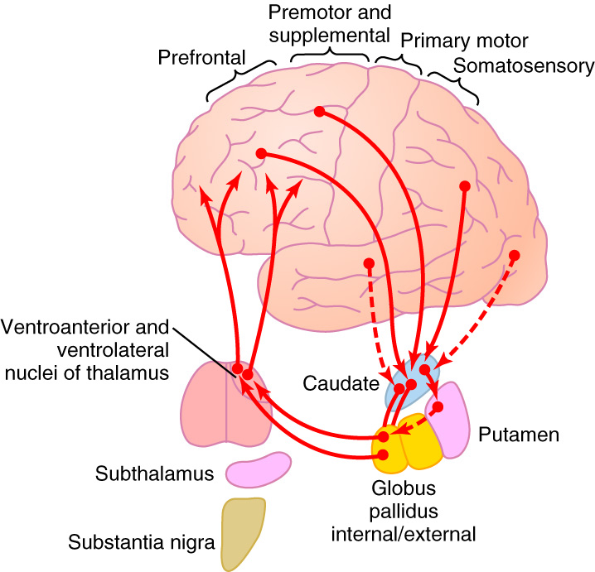
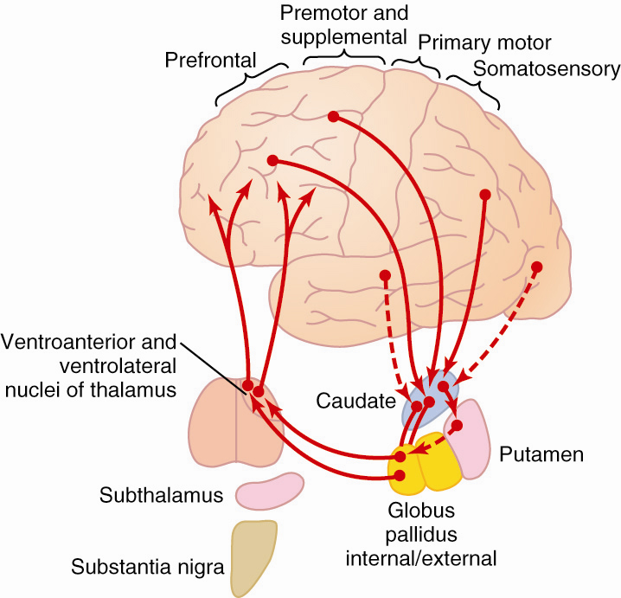
Caudate Circuit
Caudate extends into all lobes of the cortex and receives a large input from association areas of the cortex
Mostly projects to globus
pallidus, no fibers to sub-
thalamus or substantia
nigra
Most motor actions occur as a result of a sequence of thoughts. Caudate circuit may play a role in the cognitive control of motor functions

Slide 7
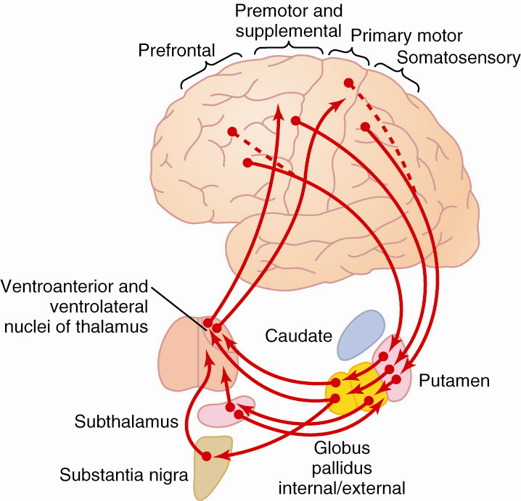
Putamen Circuit
Mostly from premotor and supplemental motor cortex to putamen then back to motor cortex.

Slide 8
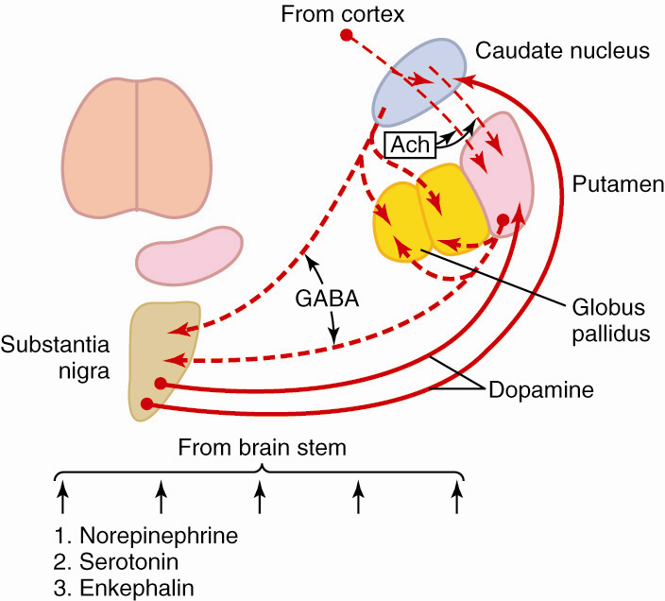
Neurotransmitters in the Basal Ganglia

Slide 9
Lesions of Basal Ganglia
globus pallidus
  athetosis - spontaneous writing movements of the hand, arm, neck, and face
putamen
  chorea - flicking movements of the hands, face, and shoulders
substantia nigra
  Parkinson's disease - rigidity, tremor and akinesia
  loss of dopaminergic input from substantia nigra to the caudate and putamen

Slide 10
Lesions of Basal Ganglia
subthalamus
  hemiballismus - sudden flailing movements of the entire limb
caudate nucleus and putamen
  huntington’s chorea - loss of GABA containing neurons to globus pallidus and substantia nigra

Slide 11
Integration of Motor Control
spinal cord level
  preprogramming of patterns of movement of all muscles (i.e., withdrawal reflex, walking movements, etc.).
brainstem level
  maintains equilibrium by adjusting axial tone
cortical level
  issues commands to set into motion the patterns available in the spinal cord
  controls the intensity and modifies the timing

Slide 12
Integration of Motor Control (cont’d)
cerebellum
  function with all levels of control to adjust cord motor activity, equilibrium, and planning of motor activity
basal ganglia
  functions to assist cortex in executing subconscious but learned patterns of movement, and to plan sequential patterns to accomplish a purposeful task

Slide 13
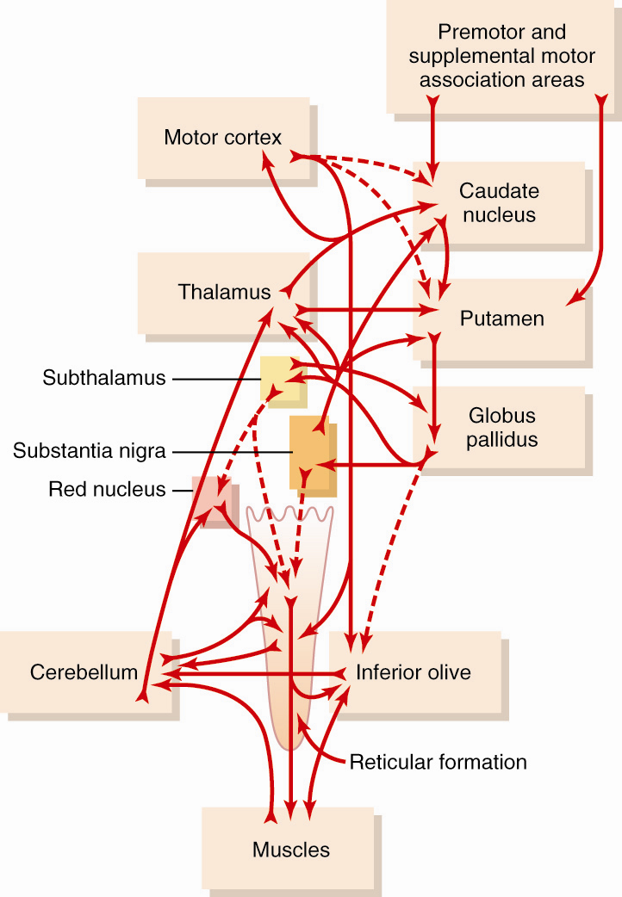
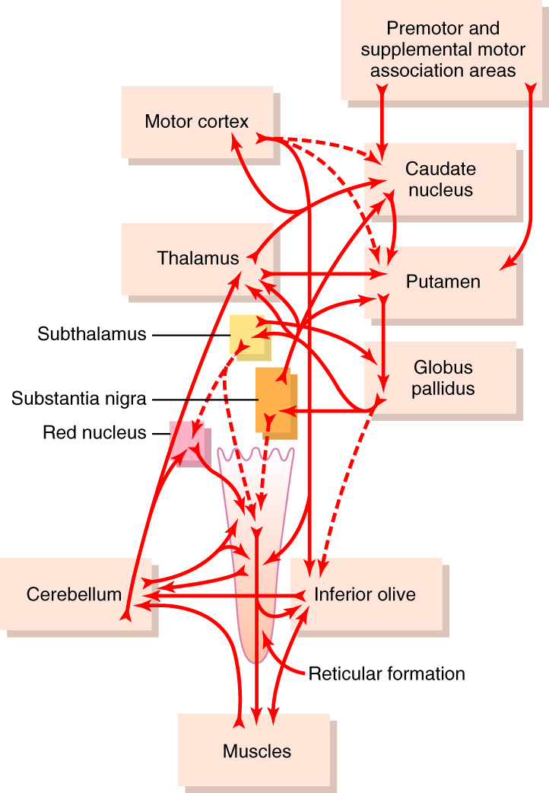
Overall scheme for
integration of
motor function

Slide 14
History of Parkinson´s disease (PD)
First described in 1817 by an English physician, James Parkinson, in “An Essay on the Shaking Palsy.”
The famous French neurologist, Charcot, further described the syndrome in the late 1800s.
Notes:
Parkinson´s disease (PD) was first described by an English physician, James Parkinson, in 1817 in “An Essay on the Shaking Palsy”. The famous French Neurologist, Charcot, further described the syndrome in the late 1800s.
Parkinson, J. An Essay on the Shaking Palsy. Sherwood, Neely & Jones, London, 1817

Slide 15
Epidemiology of PD
  The most common movement disorder affecting 1-2 % of the general population over the age of 65 years.
  The second most common neurodegenerative disorder after Alzheimer´s disease (AD).
Notes:
PD is the most common movement disorder affecting 1-2 % of the general population over the age of 65 years, and it is the second most common neurodegenerative disorder after Alzheimer´s disease (AD).
Tanner, CM et al. Epidemiology and genetics of Parkinson´s disease. In: Watts RL, Koller WC, ed. Movement Disorders, Neurologic principles and practice. New York: McGrawhill, pp. 137-152, 1997.

Slide 16
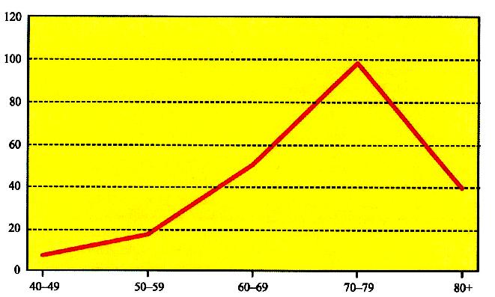
Incidence of PD
Incidence / 100 000
Age
Notes:
The incidence ratio (the number of new cases) of PD ranges from 4.5 - 21 / 100 000 population, the variation reflecting in part variations in study designs and definition of the disease (one difficulty in the epidemiological studies is accurate diagnosis of PD). The figure shows incidence rates in South-West Finland in 1992. The disease is rare before the age of 50, and both incidence and prevalence rates rise sharply thereafter. Most cases start between 50 and 70 years of age.
Marttila, R. et al. Geographic clustering of Parkinson´s disease in Finland. Eur. J. Neurol. 3(5), 187, 1996

Slide 17
Prevalence of PD
Prevalence / 100 000
Age
Notes:
The prevalence (number of existing cases) estimates of PD vary from 20 to 300 / 100 000 persons in white, for example in South-West Finland prevalence is 166 / 100 000 persons.
Marttila, R. et al. Geographic clustering of Parkinson´s disease in Finland. Eur. J. Neurol. 3(5), 187, 1996

Slide 18
Epidemiology of PD
May be less prevalent in China and other Asian countries, and in African-Americans.
Prevalence rates in men are slightly higher than in women; reason unknown, though a role for estrogen has been debated.
Notes:
Some data suggest that PD may be less prevalent in China and other Asian countries as well as in African Americans. Prevalence rates in men appear to be slightly higher than in females, the reason for this being unknown though a role for estrogen has been debated.
Marttila, R. et al. Geographic clustering of Parkinson´s disease in Finland. Eur. J. Neurol. 3(5), 187, 1996
Koller, WC and Minagan, A. Treatment strategies for the management of Parkinson’s disease. In: Parkinson’s disease management guide, Medical economics Company Inc. at Montvale NJ, pp. 101-133, 2001

Slide 19
Risk factors of PD
Age - the most important risk factor
Positive family history
Male gender
Environmental exposure: Herbicide and pesticide exposure, metals (manganese, iron), well water, farming, rural residence, wood pulp mills; and steel alloy industries
Race
Life experiences (trauma, emotional stress, personality traits such as shyness and depressiveness)?
An inverse correlation between cigarette smoking and caffeine intake in case-control studies.
Notes:
A number of risk factors have been associated with an increased risk of PD, with age being the most important one. In addition to age, male gender and race, as well as positive family history may increase the risk for PD. A variety of environmental exposures including herbicide and pesticide exposure, metals (manganese, iron), drinking well water, farming, rural residence, wood pulp mills, and steel alloy industries have been shown to increase the risk of PD. Finally, the life experiences (trauma, emotional stress, personality traits like shyness and depressiveness) may affect the risk, although this is less well proven. On the other hand, an inverse correlation between cigarette smoking and caffeine intake has been found in case-control studies, the significance of these correlations being however, unclear.

Slide 20
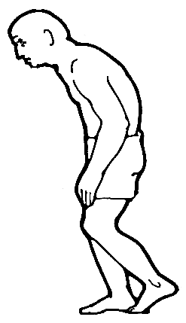
Clinical features of PD
Three cardinal features:
→ resting tremor
→ bradykinesia (generalized slowness of movements)
→ muscle rigidity
Notes:
Clinically, PD is characterized by three cardinal symptoms: resting tremor, bradykinesia (generalized slowness of movements) and muscle rigidity.

Slide 21
Clinical features of PD
Resting tremor: Most common first symptom, usually asymmetric and most evident in one hand with the arm at rest.
Bradykinesia: Difficulty with daily activities such as writing, shaving, using a knife and fork, and opening buttons; decreased blinking, masked facies, slowed chewing and swallowing.
Rigidity: Muscle tone increased in both flexor and extensor muscles providing a constant resistance to passive movements of the joints; stooped posture, anteroflexed head, and flexed knees and elbows.
Notes:
The most common first symptom is resting tremor, which is usually asymmetric and most evident in one hand with the arm at rest. It is the most easily recognized sign of the disease. The frequency of parkinsonian tremor is low, typically in the 3-6 Hz range. The alternating contraction of agonist and antagonist muscles of the forearm results in a "pill-rolling" tremor. Bradykinesia is the central motor abnormality in PD. Difficulties with daily activities such as writing, shaving, cutting food with a knife and fork and opening or buttoning buttons, as well as decreased blinking, masked facies, slowed chewing and swallowing and drooling reflect bradykinesia. Muscle tone is increased in both flexor and extensor muscles providing a constant resistance to passive movements of the joints (a "cog-wheel" rigidity can be felt during passive movements of joints). Rigidity underlies the chracteristic stooped posture, anteroflexed head, and flexed knees and elbows in the patients. The symptoms typically start asymmetrically from one side spreading from one affected limb on one side to the other limb on the same side (e.g. from hand to leg), and later also to contralateral side.
Koller, WC and Minagan, A. Treatment strategies for the management of Parkinson’s disease. In: Parkinson’s disease management guide, Medical economics Company Inc. at Montvale NJ, pp. 101-133, 2001

Slide 22
Additional clinical features of PD
Postural instability: Due to loss of postural reflexes.
Dysfunction of the autonomic nervous system: Impaired
gastrointestinal motility, bladder dysfunction, sialorrhea, excessive head and neck sweating, and orthostatic hypotension.
Depression: Mild to moderate depression in 50 % of patients.
Cognitive impairment: Mild cognitive decline including impaired visual-spatial perception and attention, slowness in execution of motor tasks, and impaired concentration in most patients; at least 1/3 become demented during the course of the disease.
Notes:
In addition to these three cardinal features, postural instability, dysfunction of the autonomic nervous system, depression and cognitive impairment are common. Loss of postural reflexes causes balance difficulties and the body can move or fall into the direction of the center of gravity. Therefore, turning or bending forward may be associated with involuntary steps. Autonomic dysfunction can result into impaired gastrointestinal motility causing sense of fulness and constipation. Furthermore, bladder dysfunction (urinary frequency, urgency and urge incontinence), sialorrhea (due to excessive saliva production and decreased frequency of swallowing), excessive head and neck sweating (resulting from altered thermoregulation), and orthostatic hypotension result from autonomic dysfunction. Approximately 50 % of patients show mild to moderate depression. Many patients show mild cognitive decline including impaired visual-spatial perception and attention, slowness in execution of motor tasks and impaired concentration. At least 1/3 of the patients become demented during the course of the disease.
Koller, WC and Minagan, A. Treatment strategies for the management of Parkinson’s disease. In: Parkinson’s disease management guide, Medical economics Company Inc. at Montvale NJ, pp. 101-133, 2001

Slide 23
Neuropathology of PD
  Eosinophilic, round intracytoplasmic inclusions called lewy bodies and Lewy neurites.
  First described in 1912 by a German neuropathologist - Friedrich Lewy.
  Inclusions particularly numerous in the substantia nigra pars compacta.
Notes:
The main neuropathological feature of the disease consists of eosinophilic, round cytoplasmic inclusions called Lewy bodies and Lewy neurites, first described in 1912 by a German neuropathologist Friedrich Lewy. In 1919 it was shown that these inclusions are particularly numerous in the substantia nigra. Later the focal distribution of pathology was shown: the most pronounced nerve cell loss is found in the pars compacta of the substantia nigra.
Lewy, F. in Handbuch der Neurologie Vol. 3 (eds Lewandowski, M. & Abelsdorff, G.) pp. 920-933, Springer Verlag, Berlin 1912
Tretiakoff 1919
Forno, L. S. Neuropathology of Parkinson's disease. J. Neuropathol. Exp. Neurol. 55, 259-272 1996

Slide 24
Lewy bodies
Notes:
On the left a Lewy body of substantia nigra section from a PD patient labeled with a polyclocal α-synuclein antibody NAC-1 at 1:100. On the right cortical Lewy bodies of cingulate gyrus labelled with NAC-1 at 1:200. Bars 20 μm.
Bayer, T. A. et al. α-synuclein accumulates in Lewy bodies in Parkinson's disease and dementia with Lewy bodies but not in Alzheimer's disease -amyloid plaque cores. Neurosci. Lett. 266, 213-216 1999 (Staining by Janetta Culvenor, Univ. of Melbourne) Reprinted with permission from Elsevier.

Slide 25
Neuropathology of PD: Lewy bodies
Not limited to substantia nigra only; also found in the locus coeruleus, motor nucleus of the vagus nerve, the hypothalamus, the nucleus basalis of Meynert, the cerebral cortex, the olfactory bulb and the autonomic nervous system.
Confined largely to neurons; glial cells only rarely affected.
Notes:
The presence of Lewy bodies is not limited to substantia nigra: they are also found in the locus coeruleus, motor nucleus of the vagus nerve, the hypothalamus, the nucleus basalis of Meynert, the cerebral cortex, the olfactory bulb and the autonomic nervous system. Lewy bodies are confined largely to neurons; glial cells are only rarely affected.
Forno, L. S. Neuropathology of Parkinson's disease. J. Neuropathol. Exp. Neurol. 55, 259-272, 1996

Slide 26
Functional neuroanatomy of PD
Substantia nigra: The major origin of the dopaminergic innervation of the striatum.
Part of extrapyramidal system which processes information coming from the cortex to the striatum, returning it back to the cortex through the thalamus.
One major function of the striatum is the regulation of posture and muscle tonus.
Notes:
Substantia nigra is the major origin of the dopaminergic innervation of the striatum and is part of so called extrapyramidal system which processes information coming from the cortex to the striatum, and returns it back to the cortex through the thalamus. One major function of the striatum, which is under the control of substantia nigra, is the regulation of posture and muscle tonus.
Source: Marsden, C. D. Parkinson's disease. Lancet 335, 948-952, 1990

Slide 27
Neurochemistry of PD
Late 1950s: Dopamine (DA) present in mammalian brain, and the levels highest within the striatum.
1960, Ehringer and Hornykiewicz: The levels of DA severely reduced in the striatum of PD patients.
PD symptoms become manifest when about 50-60 % of the DA-containing neurons in the substantia nigra and 70-80 % of striatal DA are lost.
Notes:
In late 1950s, it was shown that dopamine is present in mammalian brain, and that the levels are highest within the striatum. In 1960, Ehringer and Hornykiewicz showed that the levels of dopamine are severely reduced in the striatum of patients with PD. Degeneration of the nigrostriatal dopaminergic neurons causes symptoms of PD: symptoms become manifest when about 50-60 % of the dopamine-containing neurons in the substantia nigra and 70-80 % of striatal dopamine are lost.
Carlsson, A. The occurrence, distribution and physiological role of catecholamines in the nervous system. Pharmacol. Rev. 11, 490-493, 1959
Sano, I. et al. Distribution of catechol compounds in human brain. Biochim. Biophys. Acta 32, 586-587, 1959
Ehringer, H. & Hornykiewicz, O. Verteilung von Noradrenalin und Dopamin (3-Hydroxytyramin) im Gehirn des Menschen und ihr Verhalten bei Ekrankungen des extrapyramidalen Systems. Klin. Wschr. 38, 1236-1239 (1960)
Marsden, C. D. Parkinson's disease. Lancet 335, 948-952, 1990
Forno, L. S. Neuropathology of Parkinson's disease. J. Neuropathol. Exp. Neurol. 55, 259-272, 1996
Koller, WC and Minagan, A. Treatment strategies for the management of Parkinson’s disease. In: Parkinson’s disease management guide, Medical economics Company Inc. at Montvale NJ, pp. 101-133, 2001.

Slide 28
Dopamine synthesis
Notes:
Dopamine is synthesized from tyrosine, which is first catalysed to L-DOPA by tyrosine hyroxylase. L-DOPA is then decarboxylated to dopamine by dopadecarboxylase, and stored in the vesicles. When released into synaptic cleft, dopamine binds to receptors (D1-D5 in the figure), which activates different second messenger systems inside the cell causing changes in excitability, metabolism and gene expression. Reuptake of dopamine is by dopamine transporter. If unstored in the cytosol, dopamine is oxidized by monoamine oxidase (MAO).

Slide 29
Dopamine pathways in human brain
Notes:
The ventral tegmental area (VTA) cells project to limbic (mesolimbic projection) and cortical (mesocortical projection) areas. Neurons of the substantia nigra project to the striatum (nigrostriatal projection). In PD, dopaminergic nerve cells in the substantia nigra develop nerve cell loss, and its degeneration and the resulting striatal dopamine depletion are responsible for most of the motor abnormalities.

Slide 30
Therapy of PD: levodopa
Late 1950s: L-dihydroxyphenylalanine (L-DOPA; levodopa), a precursor of DA that crosses the blood-brain barrier, could restore brain DA levels and motor functions in animals treated with catecholamine depleting drug (reserpine).
First treatment attempts in PD patients with levodopa resulted in dramatic but short-term improvements; took years before it become an established and succesfull treatment.
Still today, levodopa cornerstone of PD treatment; virtually all the patients benefit.
Notes:
In late 1950´s, it was shown that L-dihydroxyphenylalanine (L-DOPA; levodopa), a precursor of dopamine that crosses the blood-brain-barrier, could restore brain dopamine levels and motor functions in animals treated with catecholamine depleting drug, reserpine. The observations about the striatal dopamine depletion in PD were followed by attempts to alleviate the symptoms through the administration of levodopa. First attempts resulted in dramatic but short-term improvements. It took years before this treatment become an established and succesfull treatment for PD. Still today, it continues to be the cornerstone of PD treatment. Virtually all PD patients benefit from levopoda treatment.
Cotzias, G. C. et al. Modification of parkinsonism: chronic treatment with L-DOPA. N. Engl. J. Med. 280, 337-345, 1969.
Koller, WC and Minagan, A. Treatment strategies for the management of Parkinson’s disease. In: Parkinson’s disease management guide, Medical economics Company Inc. at Montvale NJ, pp. 101-1332001.

Slide 31
Therapy of PD: limitations of levodopa
Efficacy tends to decrease as the disease progresses.
Chronic treatment associated with adverse events (motor fluctuations, dyskinesias and neuropsychiatric problems).
Notes:
Levodopa therapy has, however, its limitations. The efficacy of the therapy is greatest during the early stages of the disease, and tends to decrease as the disease progresses. Chronic levodopa treatment is also associated with the development of adverse events (motor fluctuations, dyskinesias and neuropsychiatric problems) in the majority of patients.

Slide 32
Therapy of PD: limitations of levodopa
Does not prevent the continuous degeneration of nerve cells in the subtantia nigra, the treatment being therefore symptomatic.
Notes:
Levodopa does not however prevent the continuing degeneration of nerve cells in the substantia nigra, the treatment being therefore symptomatic.
Koller, WC and Minagan, A. Treatment strategies for the management of Parkinson’s disease. In: Parkinson’s disease management guide, Medical economics Company Inc. at Montvale NJ, pp. 101-1332001.

Slide 33
Inhibition of peripheral COMT by entacapone increases the amount of L-DOPA and dopamine in the brain and improves the alleviation of PD symptoms.
Notes:
Catechol-O-methyl-transferase (COMT) inhibitors, like entacapone, which increase the bioavailability of levodopa by inhibiting COMT enzyme peripherally and thus slow down the breakdown of levodopa, can be used as adjunctive therapy to levodopa to reduce some of the adverse effects related to long-term levodopa treatment (results in smoother levodopa plasma levels, and a decrease in motor fluctuations in patients).

Slide 34
Therapy of PD: Other treatments
  DA receptor agonists (bromocriptine, pergolide, pramipexole, ropinirole, cabergoline)
  Amantadine
  Anticholinergics
Notes:
In addition to levopoda, other drugs increasing dopaminergic activity can be used as symptomatic treatments. These include e.g. dopamine receptor agonists (e.g. bromocriptine, pergolide, pramipexole, ropinirole, cabergoline) which directly stimulate striatal dopamine receptors, and are thus independent of the degenerating dopaminergic projections of the substantia nigra for their mechanism of action. Amantadine is an antiviral agent which also increases dopamine release, blocks dopamine reuptake, and stimulates dopamine receptors. It is also a non-competitive NMDA receptors antagonist. However its mechanism of action at therapeutic doses in PD is still under discussion.
Normally there is a balance between dopaminergic and cholinergic neurotransmission in the striatum, which is disrupted in PD due to dopamine depletion resulting in a state of relative cholinergic sensitivity, so that cholinergic drugs exacerbate and anticholinergic drugs improve parkinsonian symptoms. Anticholinergics can be used in younger PD patients and are useful for treating resting tremor, but adverse effects (such as memory impairments, acute confusion and hallucinations, as well as peripheral side effects) are common are limit their use.
Koller, WC and Minagan, A. Treatment strategies for the management of Parkinson’s disease. In: Parkinson’s disease management guide, Medical economics Company Inc. at Montvale NJ, pp. 101-1332001.

Slide 35
Diagnosis of PD
History and clinical examination
Positron Emission Tomography (PET) or Single-photon Emission Computed Tomography (SPECT) with dopaminergic radioligands
Exclusion of several causes of secondary Parkinsonism
Notes:
Diagnosis is of PD based on anamnesis and clinical examination (see slides 10 to 12 for clinical features). There is no disease-specific diagnostic biological marker available. Brain computed tomography (CT) scanning or magnetic resonance imaging (MRI) is usually performed. Positron emission computed tomography (PET) or single-photon emission computed tomography (SPECT) with dopaminergic radioligands can be used to show degeneration of the nigrostriatal dopaminergic system. Several causes of secondary Parkinsonism may need to be excluded (including e.g. usage of neuroleptic drugs and other drugs blocking dopamine receptors, hydrocephalus, vascular Parkinsonism resulting from infarcts, brain tumors, post-traumatic encephalopathy, tremor essentialis, and well as a multitude of degenerative and hereditary diseases like dementia with Lewy bodies, multiple system atrophy, progressive supranuclear palsy, corticobasal degeneration, Alzheimer´s and Pick´s diseases, Creutzfeldt-Jacob disease, Gerstmann-Straussler-Scheinker disease, Wilson´s disease, Huntington´s disease and Hallervorden-Spatz disease).
Koller, WC and Minagan, A. Treatment strategies for the management of Parkinson’s disease. In: Parkinson’s disease management guide, Medical economics Company Inc. at Montvale NJ, pp. 101-1332001.

Slide 36
Summary
1-2 % of the general population over the age of 65 y
Lewy bodies and Lewy neurites particularly in the substantia nigra pars compacta dopaminergic neurons projecting to striatum
DA levels severely reduced in striatum.
Resting tremor, bradykinesia, muscle rigidity
Levodopa and other dopaminergic drugs
No treatment which would prevent the continuous degeneration of nerve cells in the substantia nigra and resulting striatal DA loss
Notes:
Parkinson´s disease significantly affects the quality of life. Without any treatment, the mean duration of the disease is about 10 years and the decrease in life-expectancy about 6 years.

