Slide 1
Disorders of renal function
Dr. Mukhallad Al Janabi
MD, MSc., PhD
Department of physiology
Faculty of Medicine
Wing M2 level 0
E mail: mukmoh@just.edu.jo
Lecture materials based on text book :
Essentials of pathophysiology 4 th edition by Porth

Slide 2

Functional anatomy of kidneys

Slide 3
Three processes are involved in clearing of blood and formation of urine:
Filtration process ( occurs in the glomeruli): filtered part of free proteins- plasma
Absorption: (occurs in renal tubules).
Secretion (occurs in renal tubules).
glomerulus

Slide 4
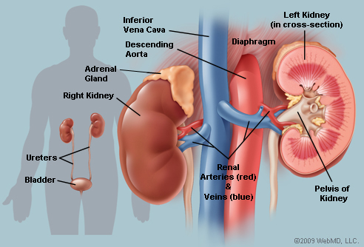
Functions of the kidneys
A. Main function:
regulation of volume & composition of body fluids, done by :
- Filtration of plasma at the glomeruli at rate of 120 ml/minute (170 L/day) this is called glomerular filtration rate (GFR).
- Absorption of selected amounts of water, electrolytes, glucose and amino acids. Also secretion of certain substances.
- Excretion of urine with waste products (1 - 1.5 liters/day)

Slide 5
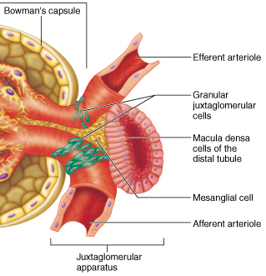
Functions of the kidneys
B. Endocrine (hormonal) function:
1. Production of:
i. Renin:
From juxtaglomerular Apparatus
which produces at the end
Angiotensin II.
ii. Erythropoietin:
From interstitial Peritubular cells → Stimulate RBCs formation.
2. Vitamin D metabolism: hydroxylation of 25-hydroxycholecalciferol to 1,25 dihydroxycholecalciferol
"Active form of Vitamin D.”

Slide 6
DISORDERS OF GLOMERULAR FUNCTION
Causes of glomerular injury :
Immunologic: etiological factor for
most cases of primary glomerular disease.
2. Nonimmunologic: includes metabolic
(like diabetes mellitus), hemodynamic (like hypertension), and toxic (like drugs, chemicals) stresses can cause damage to glomeruli.
3. Hereditary mechanisms (rare) like Alport syndrome represents a hereditary defect of the glomerular basement membrane that results in hematuria and may progress to chronic renal failure.

Slide 7
Glomerular disease due to immunological processes
Two types of immune mechanisms :
A. Injury resulting from antibodies reacting with fixed glomerular antigens or antigens planted within the glomerulus.
B. Injury resulting from circulating antigen–antibody complexes that become trapped in the glomerular membrane.

Slide 8
Types of Glomerular Disease
The clinical manifestations of glomerular disorders generally fall into one of five categories:
1. Nephritic syndromes
2. Rapidly progressive glomerulonephritis
3. The nephrotic syndrome
4. Asymptomatic disorders of urinary sediment (i.e., hematuria, proteinuria)
5. Chronic glomerulonephritis

Slide 9

Acute Nephritic Syndrome
** Acute glomerular inflammation. The inflammatory process damages capillary membrane and occludes them.
Example of this disorder is postinfectious glomerulonephritis
**Acute nephritic syndrome is characterized by
sudden onset of hematuria (blood in urine). Hematuria
is either microscopic or grossly visible, with red cell casts,
2. variable degrees of proteinuria,
3. diminished GFR,
4. oliguria, and other signs of impaired renal function.
Mechanism: Inflammatory processes that damage the capillary wall . This damage to the capillary wall allows RBCs to escape into the urine (causing hematuria).
** decrease the GFR leading to: a. edema
** Hypertension results from decrease in GFR and retention of salts and water.

Slide 10
Acute Postinfectious Glomerulonephritis
** Usually occurs after infection with certain strains of group A β-hemolytic streptococci (It develops approximately 7 to 12 days after streptococcal infection usually involves the pharynx) WHY???.
Mechanism: deposition of immune complexes of antibody and bacterial antigens.
**It also may occur after infections by other organisms, including staphylococci, a viral agent, such as hepatitis.
** Primarily seen in children, but people of any age can be affected.
Pathogenesis: diffuse glomerular enlargement and hypercellularity
(due to infiltration of leukocytes, both neutrophils and monocytes, and
proliferationof endothelial and mesangial cells) . There is also swelling of
endothelial cells.
All these changes will lead to obliteration the glomerular capillary lumens.

Slide 11
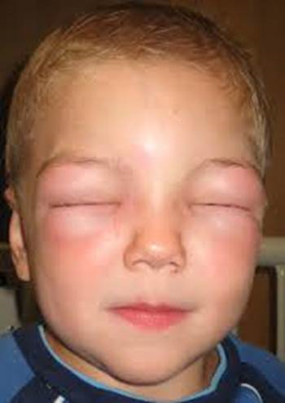
Clinical manifestation of Acute Postinfectious Glomerulonephritis
Oliguria (decrease in urine volume). It is one of the
first symptoms It is due to a decrease in GFR.
Proteinuria and hematuria follow because of
increased glomerular capillary wall permeability.
Sodium and water retention gives rise to edema (particularly of the face and hands) and hypertension.
Important laboratory findings include an elevated antistreptococcal antibody (ASO).

Slide 12
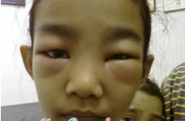
Nephrotic Syndrome
** It is resulted from an increase in glomerular permeability and loss of plasma proteins in the urine.
**It is characterized by:
Massive proteinuria ( protein in urine, mostly albumin
(more than 3.5 g/day) leading to hypoalbuminemia (less than 3 g/dL), generalized edema.
## Loss of globulins (immunoglobulins) in urine makes people with nephrosis susceptible for infections.
## Plasma levels of many ions (iron, copper, zinc) and hormones (thyroid and sex hormones) may be low because of decreased binding proteins.
2. Hyperlipidemia (cholesterol more than 300 mg/dL). elevated levels of triglycerides and low- density lipoproteins (LDLs) and this increases the risk for development of atherosclerosis.
3. There is also salt and water retention (leading to edema).

Slide 13
Glomerular Lesions Associated with Systemic Disease
In some systemic diseases, kidneys are involved in course of the disease. These diseases are :
Systemic Lupus Erythematosus Glomerulonephritis: production of autoantibodies against glomerular capillary wall.
2. Diabetic Glomerulosclerosis: It occurs in both types 1 and 2 diabetes mellitus. It involves the glomeruli ( thickening of the glomerular capillary basement membrane). As the disease process progresses, there is complete obliteration of the glomerulus, with impairment of renal function.
3. Hypertensive Glomerular Disease:
Mild to moderate hypertension causes sclerotic changes in renal arterioles and small arteries. Hypertension is the leading cause of end-stage renal disease.

Slide 14
Pyelonephritis
** infection of the renal tubules, interstitium and renal pelvis.
** mostly occurs as secondary to infection of lower urinary tract (ascending infection).
**Acute Pyelonephritis: Bacterial infection mostly by Escherichia coli (80% of cases).
Bacteria causing infection in this case are either
coming from lower urinary tract ( most of cases are
ascending infections from LUT) or
2. Coming from blood (hematogenous spread) seen in
chronically ill people.
** Sign and symptoms:
High body temperature
Ache in the loin area
Dysuria, frequency (symptoms of LUT infection)
Nausea and vomiting

Slide 15
RENAL (Kidney) FAILURE/INJURY
**Failure of kidneys functions
** these functions are in general:
1. Removal of metabolic end products from the blood
2. Regulation the fluid, electrolyte, and pH balance of
the extracellular fluids
3. Kidneys play a central role in blood pressure regulation
through the renin–angiotensin–aldosterone
mechanism and the regulation of salt and water
elimination.
4. Production of hormones (erythropoietin, Renin) and have role in activation of Vitamin D.
Done by exertion of water,
waste products, excess electrolytes, and unwanted substances from the blood

Slide 16
Acute kidney injury (Acute renal failure)
** A rapid (within 48 hours) decline in kidney function sufficient to increase blood levels of nitrogenous wastes ( an increase in creatinine level in the blood) and impair fluid and electrolyte balance ( a decrease in urine out put).
**It is reversible, if the causing factors can be corrected or removed before
permanent kidney damage has occurred.
** It has high mortality rate.

Slide 17
CAUSES OF ACUTE KIDNEY INJURY
1. Prerenal : due to less (decrease blood flow to the kidneys) decrease in systemic blood pressure. Examples
Hypovolemia, Hemorrhage, Dehydration
Excessive loss of gastrointestinal tract fluids
Excessive loss of fluid due to burn injury
Anaphylactic shock, Septic shock
Heart failure and cardiogenic shock
Decreased renal perfusion due to sepsis,
vasoactive mediators, drugs.
2. Intrarenal
Acute tubular necrosis
Prolonged renal ischemia
Exposure to nephrotoxic drugs, heavy metals, and organic solvents
Intratubular obstruction resulting from hemoglobinuria
Acute renal disease (acute glomerulonephritis, pyelonephritis)
3. Postrenal
Bilateral ureteral obstruction by stones or tumors, Bladder outlet obstruction (prostatic enlargment)

Slide 19
Prerenal injury
**The most common form of acute renal failure, is due to marked decrease in renal blood flow. It is reversible if the cause of the decreased renal blood flow can be identified and corrected before kidney damage occurs.
**Normally, the kidneys receive 20% to 25%% of the cardiac output.
** When blood flow to kidneys decreases, The glomerular filtration rate (GFR) decreases too and this leads to less excretory function of the kidneys.
**The tubular epithelial cells are most liable to ischemic injury because of their high metabolic rate.

Slide 20
Drugs and prerenal injury
NSAIDs can reduce renal
blood flow through inhibition of prostaglandin synthesis. In
some persons with diminished renal perfusion, NSAIDs can
precipitate prerenal failure.
Angiotensin-converting enzyme (ACE) inhibitors may cause prerenal failure.

Slide 21
Acute Tubular Necrosis as example of intrarenal injury
** Destruction of tubular epithelial cells.
CAUSES:
a. Ischemia
b. Sepsis
c. Nephrotoxic effects of drugs (antibiotic like
gentamicin and chemotherapeutic agents like cisplatin
and radiocontrast agents).
d. Tubular obstruction
e. Toxins from a massive infection.
Note: Tubular epithelial cells are particularly
sensitive to ischemia and also are vulnerable to toxins. The
tubular injury that occurs frequently is reversible.

Slide 22
Clinical stages of CKD
The classification of clinical stages of CKD depends on values of GFR (GFR is best measure of overall function of the kidney).
Stage one: GFR= 90 mL/ Min kidney damage but is not detected
Stage two: GFR= 60-89 mL/ Min mild decrease in GFR
Stage three: GFR= 30-59 mL/ Min moderate decrease in GFR
Stage four: GFR= 15-29 mL/ Min severe decrease in GFR
Stage five: GFR= less than 15mL/ Min shows almost all sign and symptoms of uremia. Kidney failure in this stage needs dialysis or kidney transplantation
Note: The normal GFR is approximately 120 to 130 mL/
Min in young healthy adults

Slide 23
CHRONIC KIDNEY DISEASE (CKD)
(chronic renal failure)
Loss of functioning kidney nephrons resulting in a decrease in
glomerular filtration, tubular reabsorptive capacity, and endocrine functions of the kidneys.
** Clinical Manifestations of CKD:
** Early stages of CKD is almost asymptomatic.
** When symptoms of CKD start to appear, they are non specific like weakness and fatigue.
** Elevation of nitrogenous wastes level in the blood like urea and creatinine.
**Accumulation of nitrogenous wastes in blood resulted in:
Neuromuscular disorders like fatigue, peripheral neuropathy
Gastrointestinal disorders like anorexia and vomiting
Immune dysfunction leading to infection
Dermatological symptoms like pruritus

Slide 24
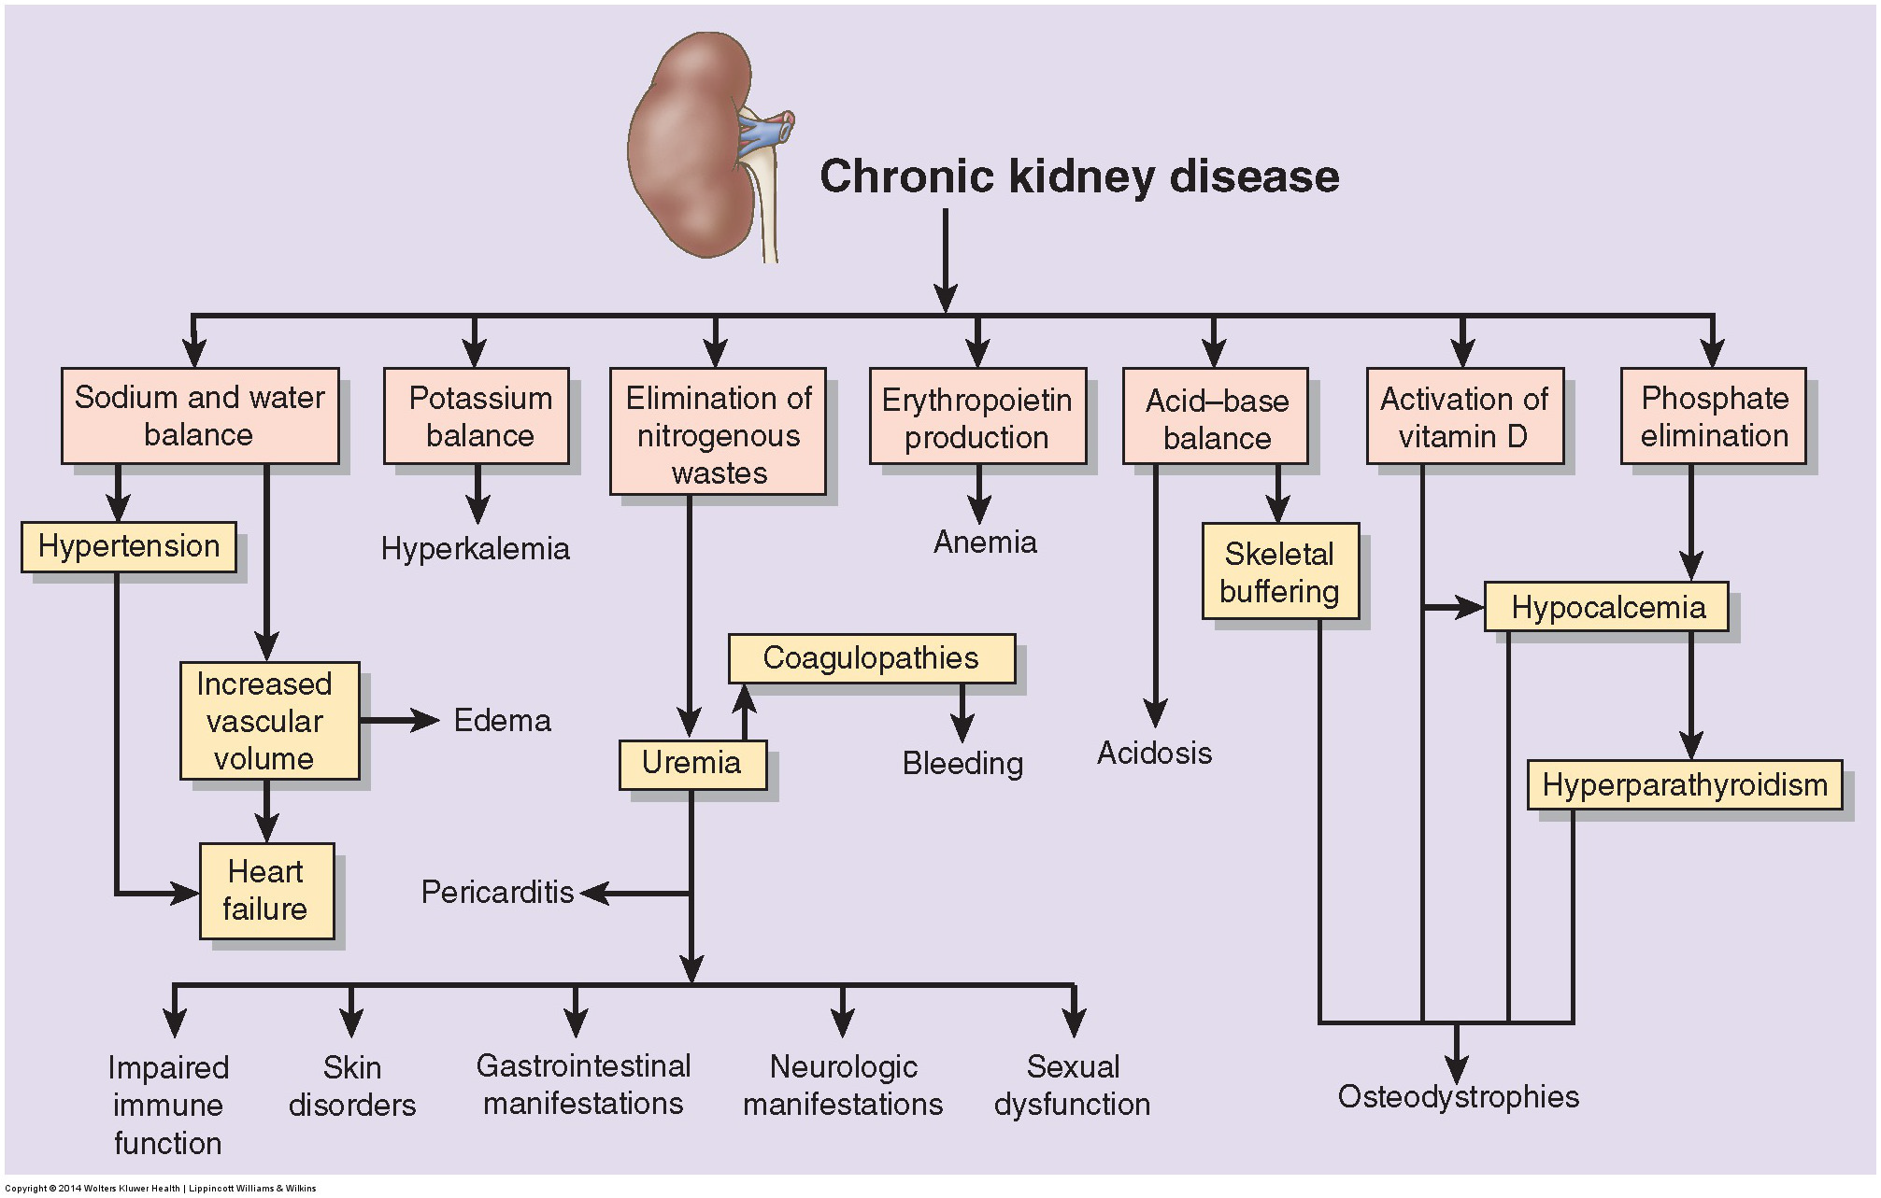

Slide 25
Clinical Manifestations of CKD
** ALMOST every organ and structure in the body is affected in CKD.
1. Fluid, Electrolyte, and Acid–Base Disorders:
Na+ and water balance……. Fluid overload or dehydration. Inability to regulate Na+ level in the blood
K+ balance ………….hyperkalemia
Acid-base balance…..acidosis
2. Cardiovascular complication
Hypertension : commonly is an early manifestation of CKD.
Hypertension is due to increased vascular volume, elevation of peripheral vascular resistance, decreased levels of renal vasodilator prostaglandins, and increased activity of the renin–angiotensin system.
b. Heart Disease: left ventricular hypertrophy , ischemic heart
disease and congestive heart failure.

Slide 26
Clinical Manifestations of CKD (cont.)
3. Gastrointestinal Disorders
Anorexia, nausea, and vomiting are common. Early morning nausea is common.
Ulceration and bleeding of the gastrointestinal mucosa may develop, and hiccups are common. Nausea and vomiting often improve with restriction of
dietary protein .
4. Disorders of Mineral metabolism:
Calcium and Phosphorus, Parathyroid hormone and vitamin D
Hyperphosphatemia, hypocalcemia, decrease in active form of Vitamin D and hyperparathyroidism
Mechanism:
phosphate excretion is impaired, and as a result serum phosphate levels rise. Serum calcium levels fall. The drop in serum calcium, in turn, stimulates
parathyroid hormone (PTH) release. Decrease formation of active form of vitamin D leads to less absorption of Ca++ from intestine and this leads to low calcium in the blood.

Slide 27
Clinical Manifestations of CKD (cont.)
5. Hematologic Disorders
Anemia : develops early in the disease
Causes of anemia in CKD:
1.chronic blood loss
2. Hemolysis
3. bone marrow suppression due to retained uremic factors
4. decreased red cell production due to impaired production of erythropoietin and
iron deficiency.
Anemia causes weakness, fatigue, depression, insomnia, and decreased cognitive
function. Anemia also limits myocardial oxygen supply, particularly in people with coronary heart disease, leading to angina pectoris and other ischemic events.
b. Coagulopathies. Bleeding disorders are manifested by epistaxis, menorrhagia, gastrointestinal bleeding, and bruising of the skin and subcutaneous tissues. Although platelet production often is normal in CKD, platelet function is impaired.

Slide 28
Clinical Manifestations of CKD (cont.)
6. Immunological disorders
Infection is a common complication of CKD. This is due to:
1. decreased granulocyte count
2. impaired humoral and cell-mediated immunity
3. defective phagocyte function.
4. impairment of the acute inflammatory response.
7. Neuromuscular Disorders
**Peripheral neuropathy, or involvement of the peripheral nerves, affects the lower limbs more frequently than the upper limbs. It is symmetric and
affects both sensory and motor function. Atrophy and demyelination of nerve fibers.
**Uremic encephalopathy may result from an excess of toxic organic acids that alter neural function. The earliest and most significant indications of uremic
encephalopathy are reductions in alertness and awareness. Delirium and coma occur in late stages of CKD.

Slide 29
Clinical Manifestations of CKD (cont.)
8. Sexual Dysfunction
Males: Impotence occurs in more than half men on dialysis. A decreased spermatocyte counts and loss of libido.
Females : Hypofertility, menstrual abnormalities.
9. Skin disorders
Skin manifestations are common in people with CKD. These include:
a. Dry skin and mucous membranes.
b. Pruritus
c. Break the skin integrity and increase the risk for infection
d. Changes in the nails

