Slide 1
Respiratory System
Second Lecture
By:
Dr. Mohammad Alqudah
Physiology department
Slides are from Dr. Othman Shboul and Chapter 13 The Respiratory System Human Physiology by Lauralee Sherwood ©2007 Brooks/Cole-Thomson Learning

Slide 2
Pulmonary Surfactant
If the alveoli were lined with water alone, surface tension would be so great that the lungs would collapse (due to great cohesive forces between water molecules)
The tremendous surface tension of pure water is normally counteracted by pulmonary surfactant

Slide 3
Pulmonary Surfactant
Mixture of lipids and proteins secreted by the Type II alveolar cells
Intersperses between the water molecules in the fluid lining the alveoli
Main role is to lower alveolar surface tension, and so:
Reduces pressure needed for subsequent alveolar inflation (i.e., increases pulmonary compliance
Prevents alveolar collapse (at end of expiration).
Newborn respiratory distress syndrome

Slide 4
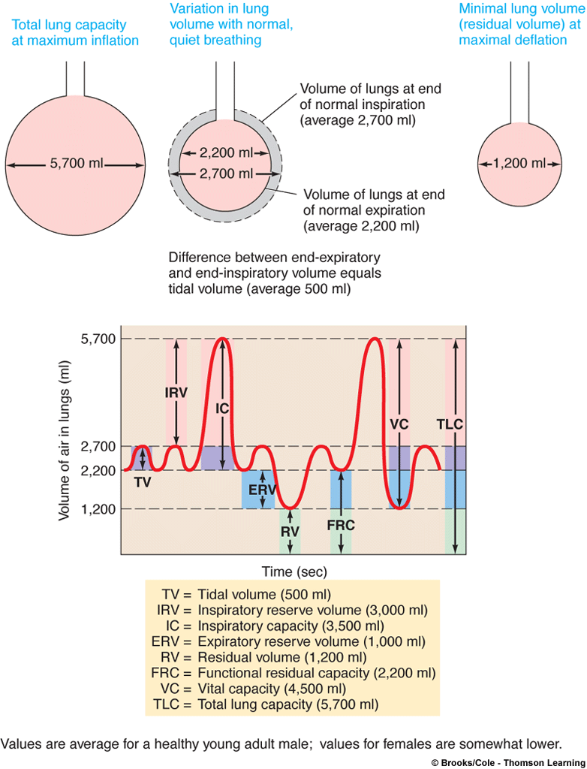
Lung Volumes and Capacities
 | Description | Average Value
Tidal volume (TV) | Volume of air entering or leaving lungs during a single breath | 500 ml
Inspiratory reserve volume (IRV) | Extra volume of air that can be maximally inspired over and above the typical resting tidal volume | 3000 ml
Inspiratory capacity (IC) | Maximum volume of air that can be inspired at the end of a normal quiet expiration (IC =IRV + IV) | 3500 ml
Expiratory reserve volume (ERV) | Extra volume of air that can be actively expired by maximal contraction beyond the normal volume of air after a resting tidal volume | 1000 ml
Residual volume (RV) | Minimum volume of air remaining in the lungs even after a maximal expiration | 1200 ml

Slide 5
Lung Volumes and Capacities
 | Description | Average Value
Functional residual capacity (FRC) | Volume of air in lungs at end of normal passive expiration (FRC = ERV + RV) | 2200 ml
Vital capacity (VC) | Maximum volume of air that can be moved out during a single breath following a maximal inspiration (VC = IRV + TV + ERV) | 4500 ml
Total lung capacity (TLC) | Maximum volume of air that the lungs can hold (TLC = VC + RV) | 5700 ml
Forced expiratory volume in one second (FEV₁) | Volume of air that can be expired during the first second of expiration in a VC determination

Slide 6
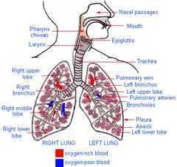
Pulmonary Ventilation
Minute ventilation
Volume of air breathed in and out in one minute
Pulmonary ventilation = tidal volume x respiratory rate
(ml/min) (ml/breath) (breaths/min)

Slide 7
Alveolar Ventilation
More important than pulmonary ventilation
Volume of air exchanged between the atmosphere and the alveoli per minute
Less than pulmonary ventilation due to anatomic dead space
Volume of air in conducting airways that is useless for exchange
Averages about 150 ml in adults
Alveolar ventilation = (tidal volume – dead space) x respiratory rate
Anatomic dead space versus alveolar dead space

Slide 8
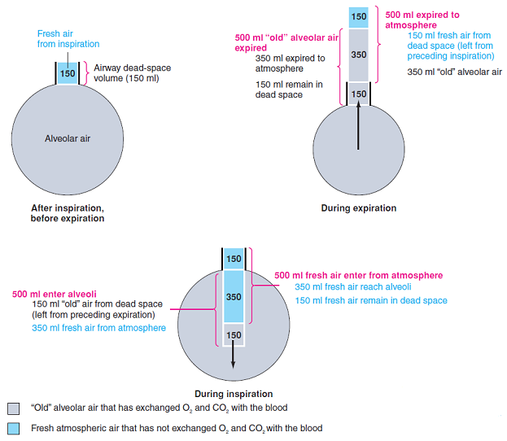
Effect of dead space volume on exchange of tidal volume between the atmosphere and the alveoli

Slide 9
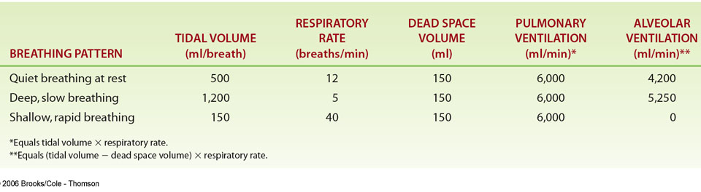
Effect of Different Breathing Patterns on Alveolar Ventilation

Slide 10
Gas exchange

Slide 11
Partial Pressure of a Gas
The partial pressure of a gas:
The individual pressure exerted independently by a particular gas within a mixture of gases is known as its partial pressure, designated by P_{gas}
Total pressure of gases:
equal to the sum of the pressures that each gas in the mixture partially contributes.
Dry air contains:
79% nitrogen (N₂)
21% O₂,
Very little percentages of CO₂, H₂O vapor, other gases, and pollutants.
Altogether, these gases in the atmosphere exert a total atmospheric pressure of 760 mm Hg at sea level.

Slide 12
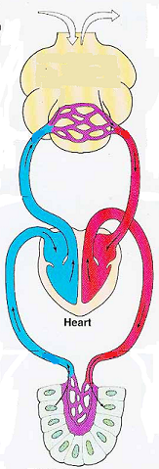
Partial pressure gradients
Gas can exert a pressure in both air and liquid; the greater the partial pressure of a gas in a liquid, the more of that gas dissolved
PARTIAL PRESSURE GRADIENTS
A difference in partial pressure between capillary blood and surrounding structures
Exist in 2 locations:
between the alveolar air and pulmonary capillary blood.
between systemic capillary blood and surrounding tissues.
alveolus
tissue
Notes:
Carbon dioxide is the most soluble
Oxygen is 1/20th as soluble as carbon dioxide
Nitrogen is practically insoluble in plasma

Slide 13
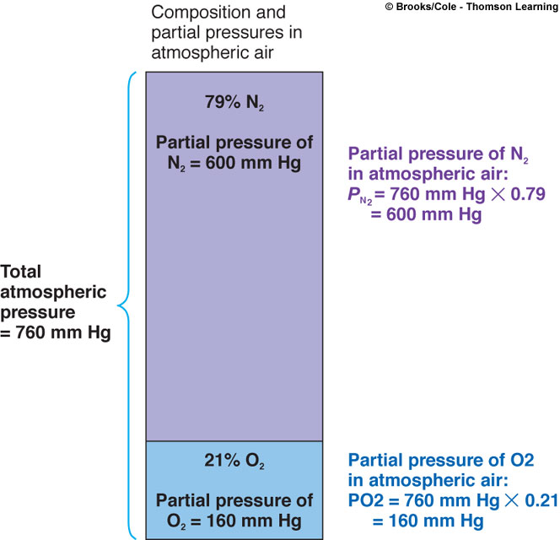
Gas Exchange
At both pulmonary capillary and tissue capillary levels, gas exchange involves simple diffusion of O₂ and CO₂ down partial pressure gradients
Partial pressure exerted by each gas in a mixture equals the total pressure times the fractional composition of this gas the mixture

Slide 14
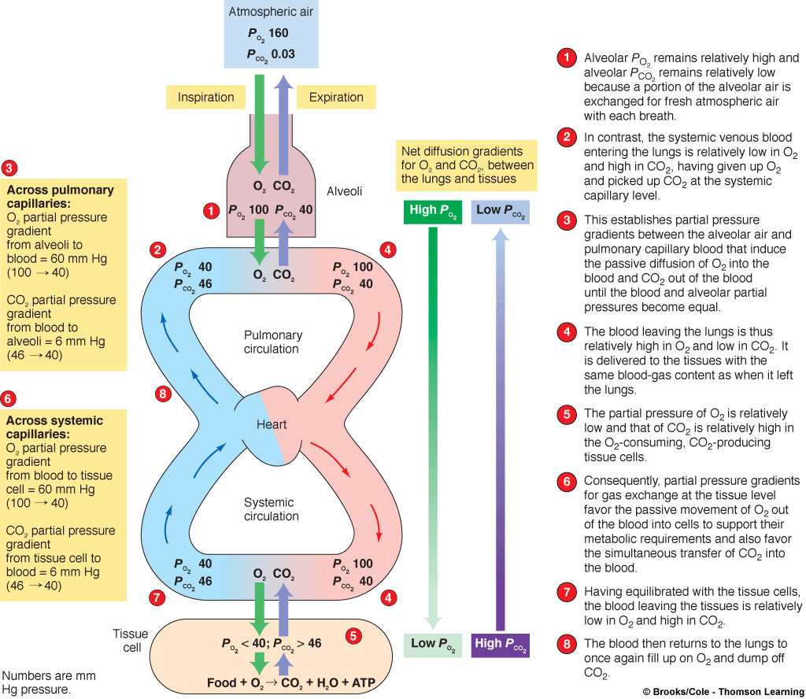
Oxygen and Carbon Dioxide Exchange Across Pulmonary and Systemic Capillaries Caused by Partial Pressure Gradients

Slide 15
Gas Exchange
Additional factors that affect the rate of gas transfer
According to fick’s low of diffusion
As surface area increases, the rate increases
Increase in thickness of barrier separating air and blood decreases rate of gas transfer
Rate of gas exchange is directly proportional to the diffusion coefficient for a gas

Slide 16
Gas Exchange
Exchange across systemic capillaries also occurs down partial pressure gradients
By equilibration in the alveoli, the oxygen in the systemic capillaries has a high partial pressure (e.g., 100) compared to tissue cells (e.g., 40). These cells are using oxygen.
The partial pressure for carbon dioxide in the systemic capillaries is low (e.g., 40) compared to the tissue cells (e.g., 46), which are making this gas through their metabolism.
By partial pressure gradients, oxygen diffuses from the systemic capillaries into the tissue cells (100 to 40, higher to lower). Carbon dioxide diffuses in the opposite direction.
Having equilibrated with the tissue cells, the blood leaving the systemic capillaries is low in oxygen and high in carbon dioxide.
This blood returns to the right side of the heart and on to the lungs. At the pulmonary capillaries, the blood acquires oxygen and releases some of its carbon dioxide.

Slide 17
GAS TRANSPORT

Slide 18
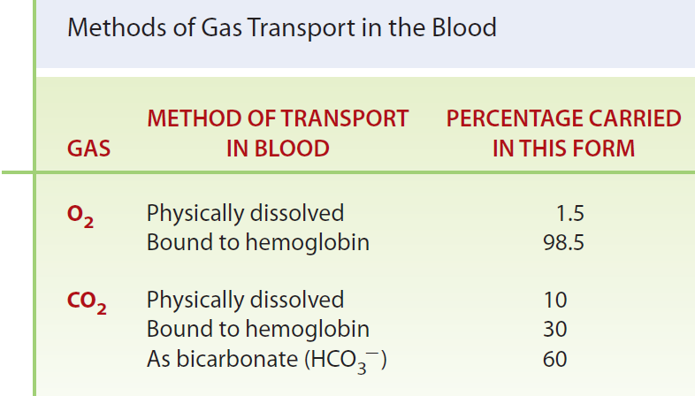
Notes:
only 3 ml of O2 can dissolve in 1 liter of blood. Thus only
15 ml of O2/min can dissolve in the normal pulmonary blood
flow of 5 liters/min (the resting cardiac output). Even under
resting conditions, the cells consume 250 ml of O2/min, and
consumption may increase up to 25-fold during strenuous
exercise. To deliver the O2 required by the tissues even at rest,
the cardiac output would have to be 83.3 liters/min if O2
could only be transported in dissolved form.
The O2 bound to Hb does not
contribute to the PO2
of the blood; thus blood PO2
is not a measure
of the total O2 content of the blood but only of the dissolved
portion of O2.

Slide 19
Transport of O₂ via Hemoglobin
Hemoglobin (Hb): 4 iron atoms each binds one O₂ molecule
The percent hemoglobin (% Hb) saturation: the extent to which the Hb present is combined with O₂ (0% to fully saturated 100%)

Slide 20
Role of PO₂
High PO₂ (alveolar capillaries): Hb loads up O₂
Low PO₂ (systemic capillaries): Hb unloads O₂
blood PO₂ is not a measure of the total O₂ content of the blood but only of the dissolved portion of O₂.
Hb + O₂ HbO₂
Hb + O₂ HbO₂

Slide 21
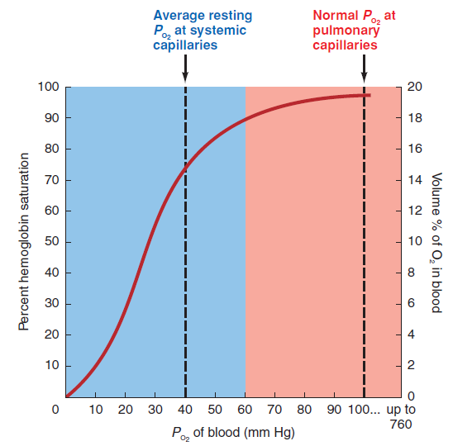
O₂–Hb Dissociation curve
Notes:
S-shaped curve, the O2–Hb dissociation (or saturation)
Curve
At 100mmHg, hemoglobin is 98% saturated
Saturation of hemoglobin is why hyperventilation has little effect on arterial O2 levels
In fact, hemoglobin is almost completely saturated at a PO2 of 70 mm Hg
Further increases in PO2 produce only small increases in oxygen binding
Oxygen loading and delivery to tissue is still adequate when PO2 is below normal levels

Slide 22
Role of Hemoglobin in O₂ exchange at the alveolar level
Hemoglobin acts as a “storage depot” for O₂
O2 stored in Hb does not contribute to blood PO2
As soon as venous blood passes through pulmonary capillaries O2 immediately diffuses from alveoli into the blood (increasing PO2)
More O₂ in blood is available to be taken by Hb
This helps lowering PO₂, so taking more O₂ from alveoli
When Hb becomes fully saturated, diffused O₂ will be in the dissolved form, so increasing PO₂ till equilibrates with alveolar PO₂, so no more O₂ diffusion.

Slide 23
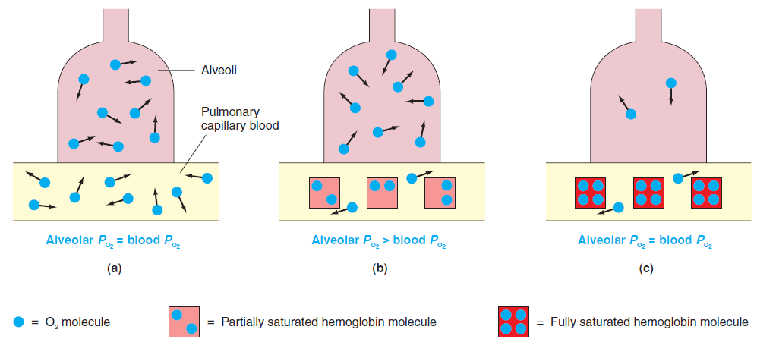
Role of Hemoglobin in O2 exchange at the alveolar level

Slide 24
Role of Hemoglobin in O₂ exchange at the tissue level
PO₂ of blood entering the systemic capillaries is considerably higher than the PO₂ of the surrounding tissue
O₂ immediately diffuses from the blood into the tissues, lowering blood PO₂
When blood PO₂ falls, Hb must unload some stored O₂, because the % Hb saturation is reduced
As the O₂ released from Hb dissolves in the blood, blood PO₂ increases and once again exceeds the PO₂ of the surrounding tissues
This favors further movement of O2 out of the blood, although the total quantity of O₂ in the blood has already fallen
when Hb is unloaded to the greatest extent possible for the PO₂ (existing at the systemic capillaries) can blood PO2 fall as low as in surrounding tissue. At this time, further transfer of O₂ stops.

Slide 25
Role of Hemoglobin in O2 exchange at the tissue level
Systemic capillary blood
Blood O2 = tissue O2
Blood O2 > tissue O2
Blood O2 = tissue O2
Tissue cells

Slide 26
Factors at the tissue level promote the unloading of O2 from hemoglobin
Effect of CO2 on % Hb saturation:
Increase in CO2 in the blood decreases the affinity of Hb for O2, so Hb unloads more O2 at the tissue level

Slide 27
Factors at the tissue level promote the unloading of O2 from hemoglobin
Effect of acid on % Hb saturation:
Increased blood acidity increases Hb release of O2
Systemic blood picks CO2 from tissues, CO2 generates carbonic acid (H2CO3), so more acidic blood

Slide 28
Factors at the tissue level promote the unloading of O2 from hemoglobin
Effect of temperature on % Hb saturation
Increase in temperature results in more unloading of O2 at a given PO2

Slide 29
Factors at the tissue level promote the unloading of O2 from hemoglobin
Effect of 2,3-bisphosphoglycerate on % Hb saturation:
Produced in RBCs
Binds reversibly with Hb and reduce its affinity for O2
Helps unload O2 from Hb at the tissue level
Produced when
Hb in the arterial blood is chronically under-saturated
High altitudes
Circulatory or respiratory diseases or anemia.

Slide 30
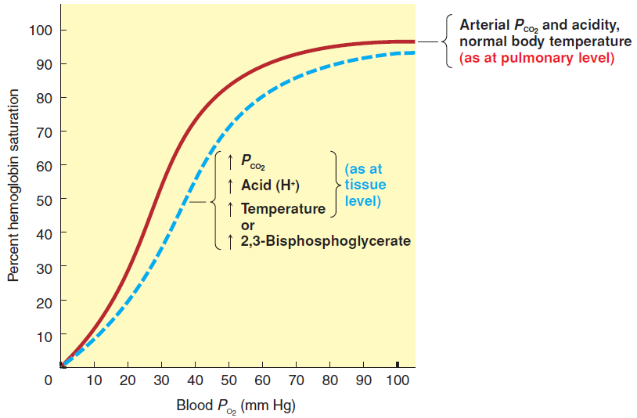
Factors at the tissue level promote the unloading of O2 from hemoglobin

Slide 31
CO2 transport in blood
Carbon dioxide is transported in the blood in three ways:
Physically dissolved
CO2 is more soluble than O2 in plasma water
10%

Slide 32
CO2 transport in blood
Bound to hemoglobin (30%)
Hb + CO2 → carbamino hemoglobin (HbCO2)
binds with the globin portion of Hb
Reduced Hb (Hb without O2) has a greater affinity for CO2 than HbO2 does.
The unloading of O2 from Hb in the tissue capillaries therefore facilitates the picking up of CO2 by Hb.

Slide 33
CO2 transport in blood
As bicarbonate (60%)
HCO3⁻ is more soluble in the blood than CO2
Reduced Hb has greater affinity for H+
In RBC

Slide 34
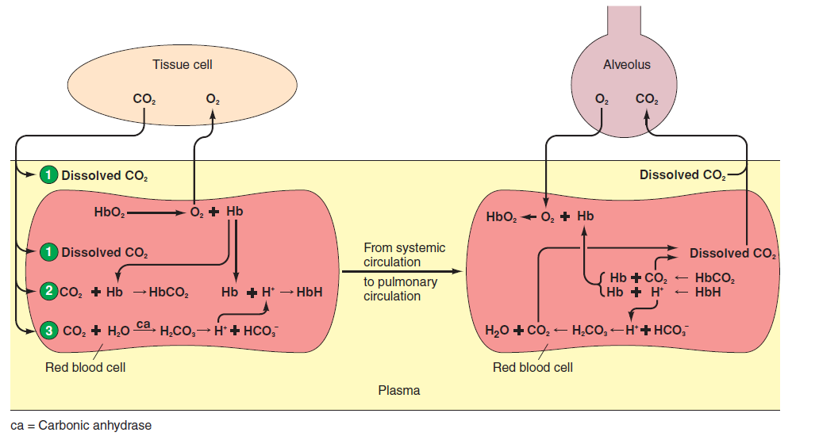
CO2 transport in blood

Slide 35
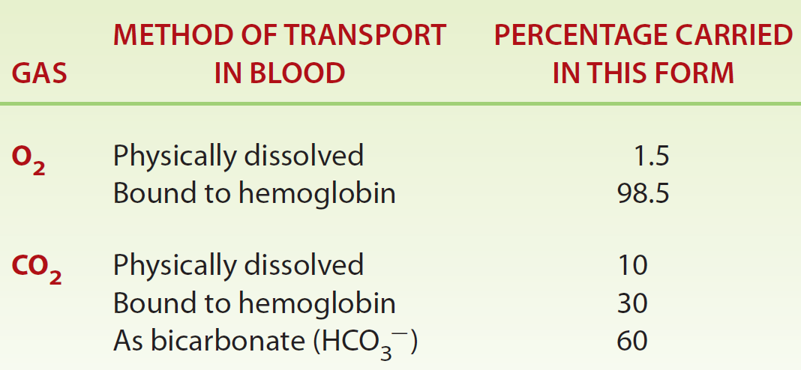
Methods of Gas Transport in the Blood

