Slide 1
The Nurse as Supervisor and Evaluator
Ellis: Chapter 7, pages 203-210, 212-224

Slide 2
Nurse unit managers function as supervisors for the care of patients
These managers are also required to perform performance feedback to other nurses they supervise
Performance feedback provides individuals with information on their own behavior in relationship to expectations and standards.
Feedback on performance is an aspect of motivation
High-quality health care

Slide 3
Supervision
A supervisor is one who has the authority to hire and fire or make the recommendations that result in those actions.
A supervisor involves total oversight of performance in order to determine whether outcomes are being met.

Slide 4
Supervision and Evaluation
Includes assuring that:
the person understands the expectations,
the work is assigned and structured appropriately,
the work is observed, and performance is evaluated against the expectations

Slide 5
Providing guidance for the accomplishment of a task or activity with direction, and periodic inspection of accomplishment
Simultaneously we evaluate the outcome for the patient and performance

Slide 6
Performance Appraisal
…is a control process in which employees' performances are evaluated against standards.

Slide 7
Performance Appraisal
Performance appraisal : A method of formally evaluating the work of an employee
Performance appraisal in nursing is assurance of nurse competence to provide patient services.
P.A It is done periodically to evaluate how well personnel have performed their jobs during a specific period (typically annually).

Slide 8
Performance Appraisal
P.A Probably the most personal thing a manager will ever do to an employee
P.A When done correctly, is one of the greatest tools an organization has to develop and motivate staff
P.A When done poorly, has the potential to discourage and demotivate

Slide 9
Performance Appraisal
The goal OF P.A is to:
Improve performance
Fulfill the job description requirements
Improve skills
Reward employees
Match the right people to the right job

Slide 10
Performance Appraisal
P.A Occurs between managers and employees
P.A involves interaction
P.A providing evaluation in writing
P.A a formal interview,
P.A follow-up for feedback

Slide 11
Performance Appraisal
P.A should be continual,
P.A aimed at educating through coaching, counseling, on-going, non-threatening
P.A is supposed to be positive for improving and developing employees
P.A identifying gaps in their knowledge and abilities and to develop those
P.A assist in identifying learning needs
P.A reward people, reinforce positive behavior
if we are not satisfied with people’s performance it (P.A) can be used as a way to document reason’s for termination.

Slide 12
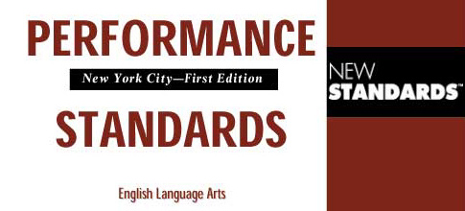
Performance Standards
Performance Standards are the measuring sticks for quantitative and qualitative evaluation of the individual’s performance.

Slide 13
Performance Standards
Job descriptions
Policies and procedures
Standards of practice
Standards of care

Slide 14
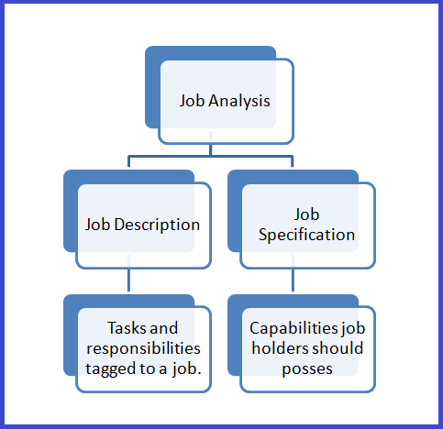

Slide 15
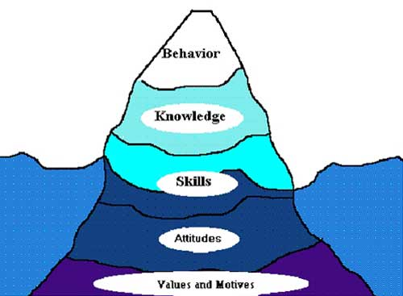
Job Analysis
identifies, specifies, organizes, and displays the duties, tasks, and responsibilities actually performed by the incumbent in a given job.

Slide 16
A job analysis is the process used to collect information about the duties, responsibilities, necessary skills, outcomes, and work environment of a particular job.

Slide 17
Job Description
Is a contract that includes the job’s functions and obligations and specifies the person to whom the employee is responsible.
Because job descriptions are guides, rigid application can result in negative behavior.

Slide 18
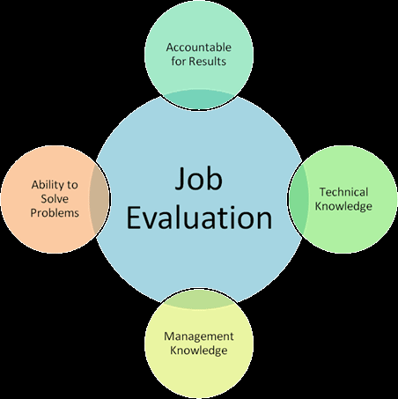
Job evaluation
Is a process used to measure exact amounts of base elements found in a job such as know-how, problem-solving, and accountability.

Slide 19
Peer Rating
- are a professional model of performance appraisal
Self ratings:
are a system of performance appraisal in which employees learn to rate themselves.

Slide 20
Performance Standards Derived From:
Job analysis details duties, tasks, responsibilities, actually performed on job
Job descriptions:
Contract
Describe a job
Job title, Basic functions, Scope, Duties
Responsibilities, Organizational responsibilities
Limits of authority
Criteria for performance evaluation

Slide 21
Performance Standards Derived From
Uses
Salary structure
Job relationships
Analyze duties
Evaluate job performance
Orientation
Hiring and placement
Identify training needs
Continuity of operations
Improve work flow
Communication
Job specifications
Planning staffing levels

Slide 22
In a performance appraisal, actual performance, not intent, is evaluated

Slide 23
What are the Purposes of a Performance Appraisal?

Slide 24
Purposes Of Performance Appraisal
For merit pay increases
Looks backward at past performance
Looks at total performance
Compare individuals doing same jobs
Is subjective
Done in emotional climate

Slide 25
To determine job competence
Enhance staff development
Motivation
Award for accomplishments
Improve communication
Career planning
Strategic planning
Identify strengths and weaknesses
Salary increases
Terminations

Slide 26
To facilitate performance
Looks ahead
Concerned with detailed performance
Compared with expected standards, goals, and objectives.
Done in calm climate

Slide 27
Types of Performance-Appraisal Tools
Forced choice or rating scales
Interpersonal comparisons
Checklists
Essay or free-form review
Self-appraisal
Peer review
Critical incident review
Management by objectives

Slide 28
Pitfalls in Performance Appraisal
Subjectivity (always a factor)
Tendency to be lenient
Inadequate record keeping
“Recency effect”

Slide 29
Other Common Pitfalls of Performance Appraisal
“Halo effect”
“Horns effect”
“Central tendency”
Contrast error

Slide 30
The halo error : Is the result of allowing one trait to influence the evaluation of other traits/ or of rating all traits based on a general impression.
The horn error : Is the opposite of the hallo effect (error). The evaluator is hypercritical….managers who are perfectionists may rate personnel lower than they should.

Slide 31
Central tendency bias refers to a tendency for raters, or managers to evaluate most of their employees as "average" when they apply a rating scale. So, for example, given a scale that runs with points on it that run from one (poor) to seven (excellent), with four being the average, many managers will refuse to use the points at either of the ends.

Slide 32
within the 3-5 range. This can be problematic since a very poor employee may be rated slightly above average even though this rating is inaccurate, or, on the other side, a superior employee may be rated in that same 3-5 range even though he or she deserves a more excellent rating.

Slide 33
The contrast error : Is produced by the tendency of managers to rate the nurses opposite from the way they perceive themselves.
Some managers may be easy and lenient, whereas others may be severe in their judgment.

Slide 34
Effective Performance Appraisals
Appraisals must be based upon a standard that all employees are held accountable to, and this standard must be communicated at the time of hire.
Employees must have input into the development of the standards or goals against which performance is judged.

Slide 35
Effective Performance Appraisals
Employees must know in advance what happens if standards are not met.
Employees must know how information will be obtained to determine performance level.
Appraisers should be those who directly supervise the employee.

Slide 36
Effective Performance Appraisals
Positive outcomes are more likely if the appraiser is looked upon with trust and professional respect.
The employee’s past experiences with performance appraisals (negative or positive) will have an influence.

Slide 37
Effective Performance Appraisals
Avoid surprises in the appraisal conference.
The effective leader coaches and communicates informally with staff continually, so there should be little new information at an appraisal conference.

Slide 38
Coaching as Part of Performance Appraisal Process
The effective manager and astute( old in service) leader are aware that day-to-day feedback regarding performance is one of the best methods for improving work performance and building a team approach.

Slide 39
Coaching as Part of Performance Appraisal Process
Coaching Is the Day-to-Day Process of Helping Employees Improve Performance
Steps of Successful Coaching:
State targeted performance in behavioral terms
Tie the problem to consequences
Avoid jumping to conclusions
Ask the employee for his or her suggestions and discuss how to solve the problem
Document required behavioral steps as indicated
Arrange for a follow-up meeting

Slide 40
Reflective Practice or Clinical Coaching Reflective Practice or Clinical Coaching
The manager or mentor meets with an employee regularly to discuss aspects of their work.
Both individuals determine the agenda,
The goal is establishing an environment of learning that can span the personal and professional aspects of the employee’s experience.

Slide 41
Performance Management
Appraisals are eliminated as the manager places his or her efforts into ongoing coaching, mutual goal setting, and the leadership training of subordinates.
The performance-management calendar is generally linked to the organization's business calendar.

Slide 42
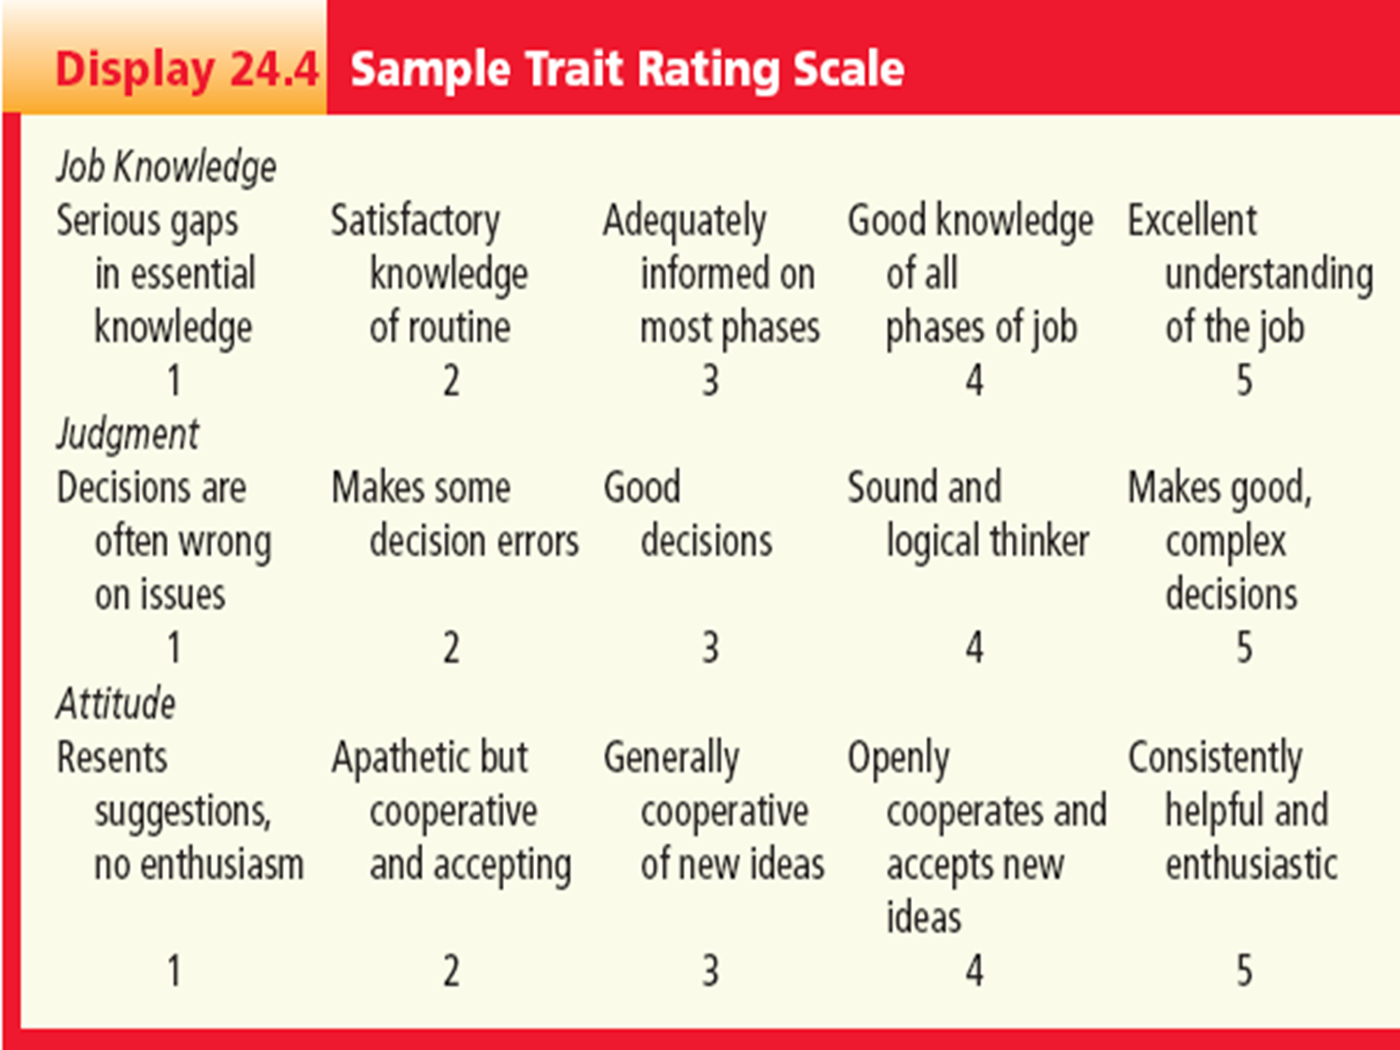

Slide 43
Factors Influencing Effective Appraisal
should be based on a standard.
Employee should have input into development of the standard.
Employee must know standard in advance.
Employee must know sources of data gathered for the appraisal.
Appraiser should be someone who has observed employee’s work.
Appraiser should be someone the employee trusts and respects.

Slide 44
Conventional performance appraisal
is a systematic standardized evaluation
Can be complemented by peer and self-evaluation
Peer evaluation or peer review is written or verbal, peers who are knowledgeable about the employees level of performance

Slide 45
In the conventional performance appraisal or review process, the manager annually writes his opinions of the performance of a reporting staff member on a document supplied by the HR department. In some organizations, the staff member is asked to fill out a self-review to share with the supervisor

Slide 46
Most of the time, the appraisal reflects what the manager can remember; this is usually the most recent events.
Almost always, the appraisal is based on opinions as real performance measurement takes time and follow-up to do well.
The documents in use in many organizations also ask the supervisor to make judgments based on concepts and words such as excellent performance , exhibits enthusiasm , and achievement oriented

Slide 47
Performance of individuals typically combines:
ability (learned or natural)
motivation (willingness and desire to perform work)

Slide 48
Evaluation has high subjectivity:
subjective evaluation by the evaluator (value system, expectations) these influence his ratings and evaluation

Slide 49
Problem areas
Recent performance most influential
Focus on outstanding events
Personal feelings - halo effect
Lack of yardsticks
Rater attitudes
Leniency/stringency error
Similar-to-me error The tendency to more favorably judge those people perceived as similar to the leader.

Slide 50
Questions to Ask Yourself to Avoid Rater Errors
• Am I basing my rating on documentation of my observations of the Employee’s behavior, or am I making judgments based on my perceptions?
• Am I looking at each of this Employee’s competencies separately, or have I generalized about his or her performance?
• Have I looked at this Employee’s competencies over time, or have I generalized according to initial perceptions of her or him?
• Have I recognized any biases I may have so I do not let them influence my judgments?
• Have I rated this Employee on his or her actual behavior or have I rated her or him compared to other individuals?

Slide 52
Errors In Performance Evaluation
Humans typically err and evaluation is an area that is highly subjective and subject to errors.
Common errors in evaluation: evaluators eror in evaluation
Halo effect: occurs when evaluators rank all categories high when an individual does well in several areas but not all (on basis of general impression)
One trait influences evaluation of other traits

Slide 53
Errors In Performance Evaluation
Recency effect: occurs when the evaluator rates the employee based on recent events rather than the full year.
Problem distortions effect: when the evaluator can only remember the problems with the employee
Sunflower effect: evaluators rate everyone high because they are part of a high performance team

Slide 54
Errors In Performance Evaluation
Central tendency: evaluator rates everyone average in order to prevent conflict
Rater temperament effect: the boss errs on the side of leniency or strictness in evaluation
Guessing-error effect: when the evaluator is behind in his work and estimates performance instead of collecting objective data

Slide 55
Performance Management Tools (Methods)
Anecdotal notes: written data about employee performance
Objective, written description of who was observed, by whom, when, where, how (details)…avoiding value-laden words, such as good, bad.
You can’t judge people unless there is an obvious pattern of behavior, can be observed over times on different occasions.
Open-ended essays: written description of employee performance
Checklists: identify desired behavior or activities using categories

Slide 56
Performance Management Tools (Methods)
Rating scales: assess each behavior on a numerical scale 1-5, not just absence or presence of the behavior
Behaviorally-anchored rating scales: documentation of behavior as well as ranking the expected behavior is clarified by giving examples which limits the personal judgment needed by the rater
Ranking: rank nurses from highest to lowest. Compare each nurse to another (paired comparison).

Slide 57
Evaluation Standards:
Always remember that evaluations can be based on different standards:
Absolute standard: the evaluator’s personal expectations of employees based on his value and judgment……or let’s say standards that the organization sees important
Comparative standard: a measurement system in which employees are compared to one another and ranked accordingly.

Slide 58
Management by objectives (MBO)
Management by objectives (MBO) This philosophy was proposed by Peter Drucker in 1954 Philosophy of management that rates performance on the basis of employee achievement of goals These goals are set by mutual agreement of employee & manager

Slide 59
Performance Appraisal under an MBO Program
Step 1: Organization goals & metrics
Step 2: Department goals & metrics
Step 3A: Superior lists goals for subordinates
Step 3B: Subordinate proposes goals
Step 4: Mutual agreement of goals
Step 5A: Inappropriate goals deleted
Step 5B: New inputs are then provided (interim review)
Step 6: Final review
Step 7: Review of organization performance

Slide 60
Management by Objectives (MBO)
is another method for evaluating performance.
measures individual performance in terms of end results of behavior.
is based on focusing attention to individual achievement of organizational objectives….working towards achieving objectives…
does not look at personality characteristics
works on motivating employees to accomplishment

Slide 61
Management by Objectives (MBO)
Manager and staff nurses work together to:
identify areas the nurse is expected to work,
set standards
determine expected results to achieve
Set a timeframe.
To set these objectives:
organizational objectives,
review the mission,
Group objectives (analyze why we are here…what we do…and what we think we should do, describe job, and clarify its purpose)

Slide 62
Management by Objectives (MBO)
determine expected levels of accomplishment:
avoid too many objectives, too complex, imbalanced emphasis, too high or too low standards; time period is to long or too short…
Advantages: nurses have input and some control over what happens….
They know how they will be judged, by what standard and so

Slide 63
Performance Appraisal
In summary, performance appraisal:
Is a method for rewarding and developing employees
Managers need training in evaluation
We need to base our evaluation on job descriptions
Match job expectations with evaluation
Involve employees in evaluation (self and peer review)
Separate evaluation from counseling
Generate useful information for decisions (termination, rewarding, training)

Slide 64
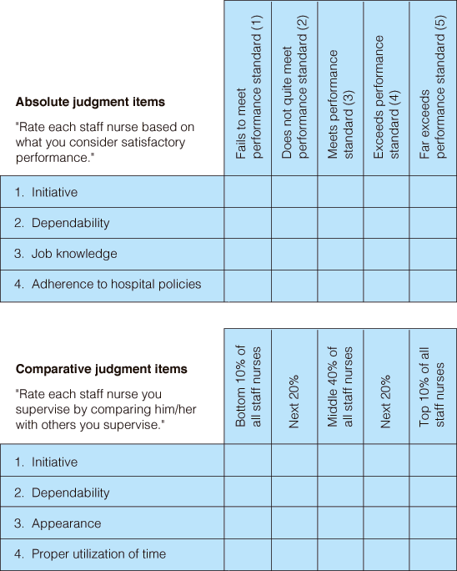

Slide 65
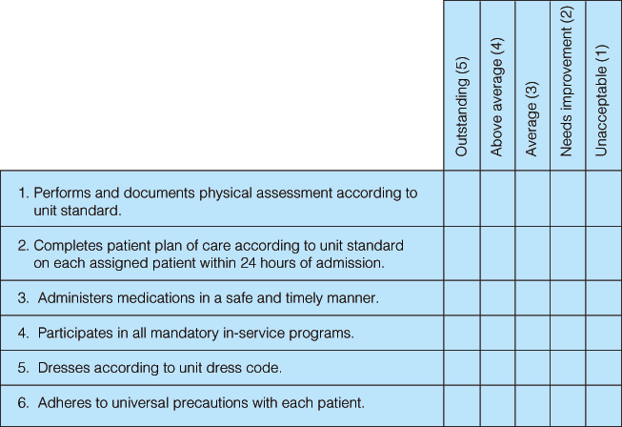

Slide 67
Because of past experiences, performance appraisal interviews are highly charged, emotional events for most employees.

