Slide 1
The Urinary System
Dr. Ahmed Al-Dwairi
Department of Physiology

Slide 2
Lecture Objectives
Functions of the renal system
Physiologic anatomy of the renal system
Nephron; components & functions
Filtration
Reabsorption
Secretion
Renal excretion
Countercurrent multiplication
Micturition reflex

Slide 3
Functions of the Urinary System
Contributing to homeostasis
Controlling electrolyte and water balance of the ECF, plus urinary output.
If the ECF has an excess of water or electrolytes, the kidneys eliminate the excess. If there is a deficiency of these substances, the kidneys can reduce the loss of these from the body.
Maintaining the proper osmolarity of body fluids
Maintaining proper plasma volume
Helping to maintain proper acid-base balance
Excreting wastes of body metabolism
Excreting many foreign compounds
Producing erythropoietin and renin
Converting vitamin D to an active form
Notes:
Secretion of prostaglandin

Slide 4
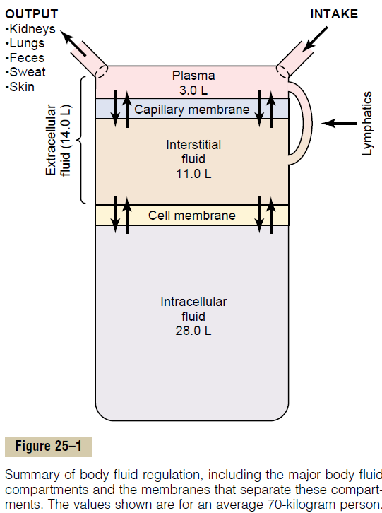
Body fluid regulation
Guyton and Hall, Medical physiology 11th edition.

Slide 5
Physiologic Anatomy
Kidneys
– The functional units of the system
Ureters
Conducting & Storage components
Urinary Bladder
Urethra

Slide 6
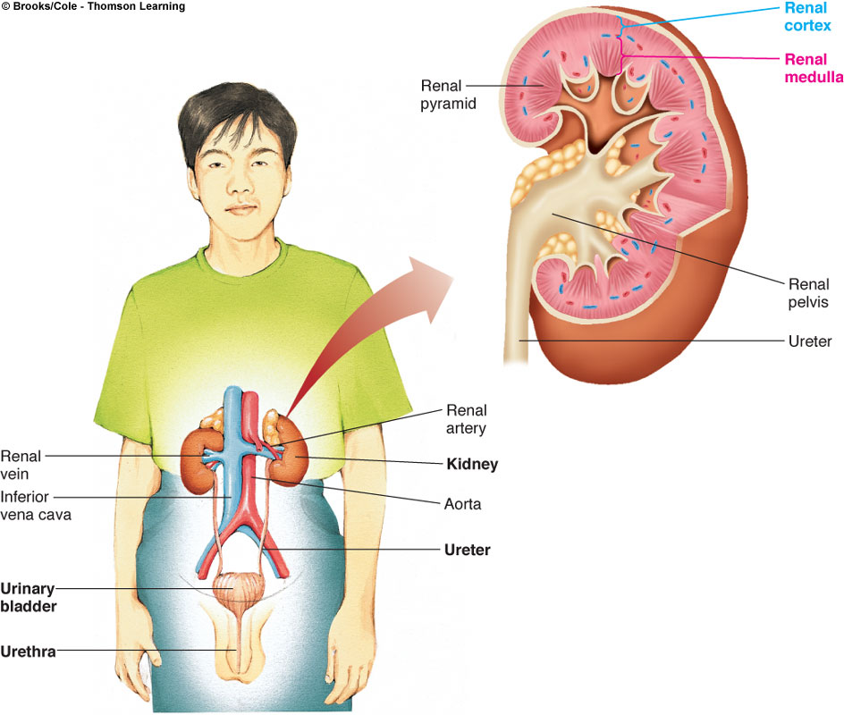
Physiologic Anatomy
Each kidney is supplied by a renal artery and renal vein. The kidney acts on the blood plasma flowing through it.
As urine is formed, it drains into the renal pelvis and is channeled into the ureter.
The urine is stored in the urinary bladder. It is emptied periodically through the urethra.
The urethra serves the urinary and reproductive tracts in the male.

Slide 7
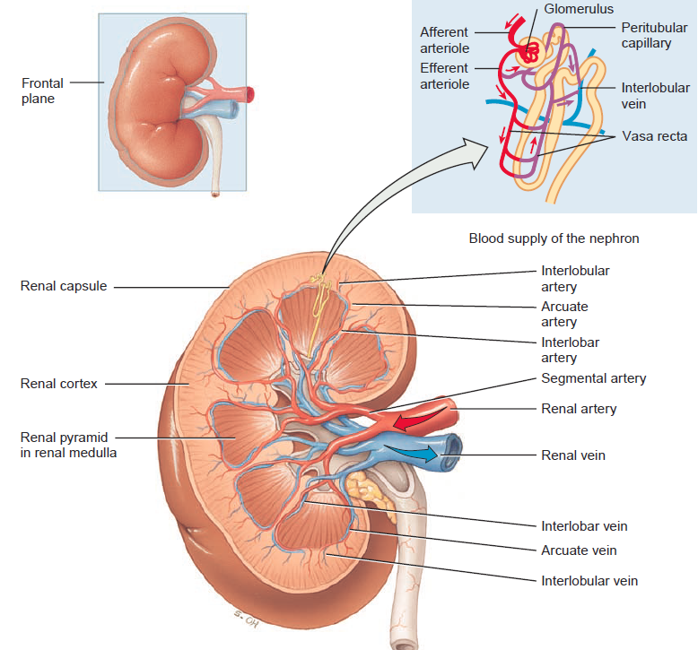
Guyton and Hall, Medical physiology 11th edition.

Slide 8
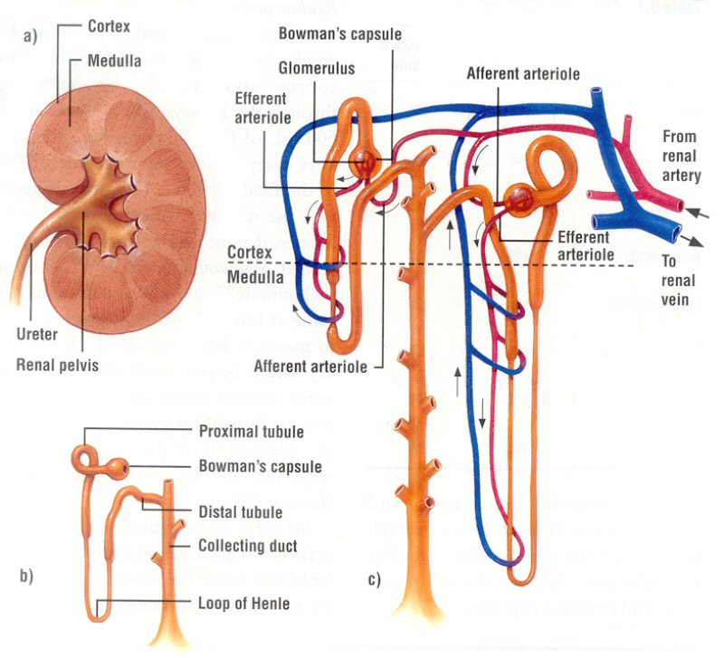
The nephron; the functional unit of the kidney
Nephron is the smallest unit that can perform all the functions of the kidney. Each kidney has about one million nephrons.
Kidney layers:
Cortex: the outer layer, looks glomerular.
Medulla: the inner layer made up of striated triangles; the renal pyramids.
The nephrons are arranged through the cortex and medulla of the kidney.
Each nephron consists of:
Vascular component
Tubular component.

Slide 9
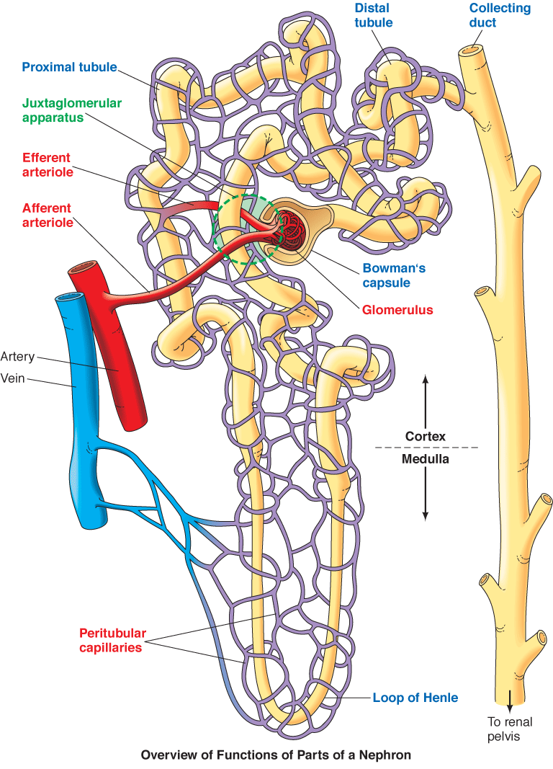
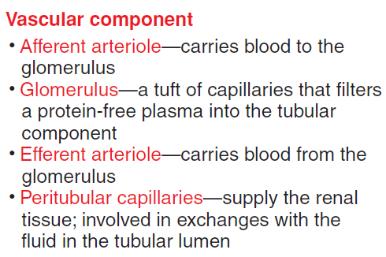
The vascular component; the dominant portion of the nephron

Slide 10
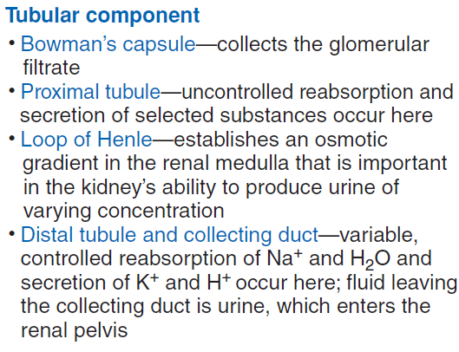
The tubular component; a hollow tube with different regions
Renal corpuscle – the glomerulus and its Bowman’s capsule

Slide 11
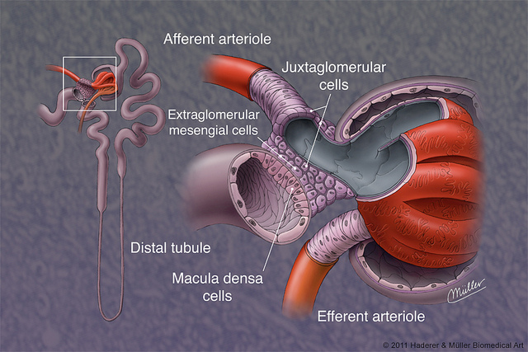
Juxtaglomerular Apparatus
Combined vascular/tubular microscopic structure in the kidney regulating the function of each nephron
Between the vascular pole of the renal arterioles and the returning distal convoluted tubule of the same nephron
Cellular components of the apparatus:
Macula densa of the distal convoluted tubule,
Senses any increase in sodium chloride concentration in the distal tubule of the kidney and secretes a locally active (paracrine) vasopressor which acts on the adjacent afferent arteriole
Smooth muscle cells of the afferent arteriole
Juxtaglomerular cells (granular cells),
Secrete renin

Slide 12
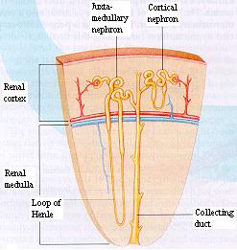
Types of Nephrons
Cortical nephron
Glomeruli in outer cortex & short loops of Henle that extend only short distance into medulla
Majority of nephrons
Cortical interstitial fluid 300 mOsmolar
Juxtamedullary nephron
Glomeruli in inner part of cortex & long loops of Henle which extend deeply into medulla
Blood flow through vasa recta in medulla is slow
This nephron maintains osmolality in addition to filtering blood and maintaining acid-base balance

Slide 13
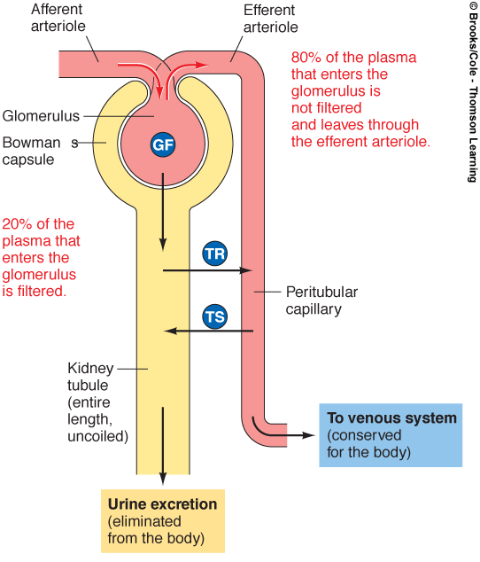
Basic Processes of the Nephron
Glomerular filtration is the first process. A protein-free plasma is filtered from the glomerulus into the Bowman’s capsule. Blood cells are not normally filtered. Normally about 20 % of the plasma is filtered. Glomerular filtrate is produced at the rate of 125 ml per minute (180 liters per day).
The 80% of the plasma not filtered passes into the efferent arteriole and through the peritubular capillaries.
Tubular reabsorption, filtered substances move from the inside of the tubular part of the nephron into the blood of the peritubular capillaries. The reabsorption rates of most substances are very high. (of the 180 liters filtered, 178.5 liters are reabsorbed)
Tubular secretion is a selective process by which substances from the peritubular capillaries enter the lumen of the nephron tubule.
Urine excretion results from these three processes
= GF – TR + TS

Slide 14
Glomerular Filtration

Slide 15
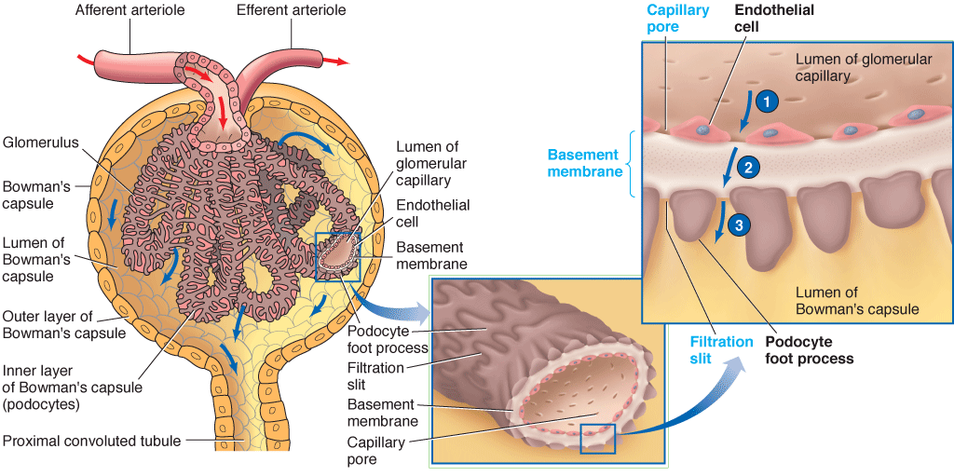
Nephron Filtration Membrane
The glomerular membrane: Single layer of flattened endothelial cells. It is fenestrated and is more permeable to water and solutes compared to other body capillaries.
The basement membrane is a gelatinous acellular layer between the glomerulus and Bowman’s capsule.
The inner layer of Bowman’s capsule contain podocytes that encircle the glomerulus tuft (forming filtration slits).
Normally blood cells and plasma proteins are not filtered.

Slide 16
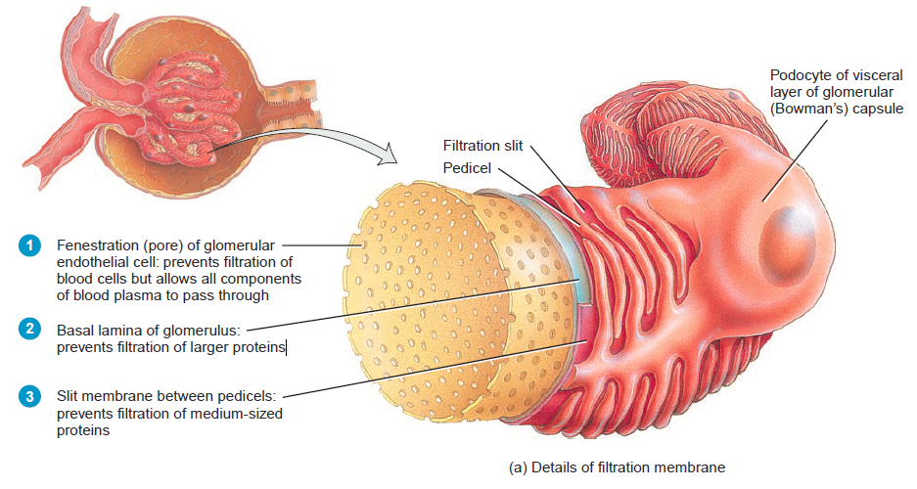
The filtration membrane
Guyton and Hall, Medical physiology 11th edition.

Slide 17
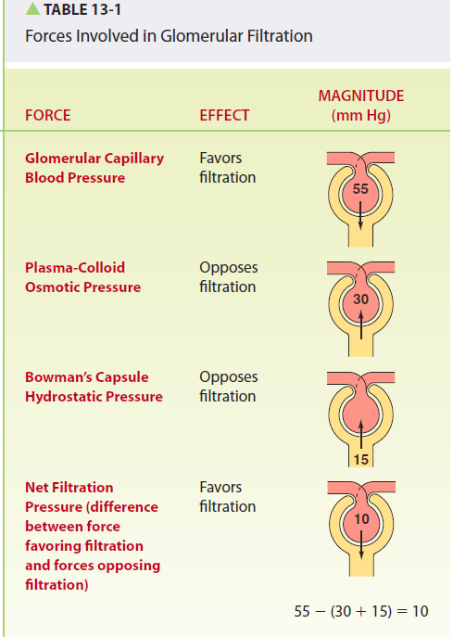
Glomerular Filtration Forces
No active transport mechanisms or local energy expenditure are involved in in moving fluid across the glomerular membrane into Bowman’s capsule.
Passive physical forces, with the same principles of fluid dynamics are involved in filtration:
The glomerular capillary pressure is the result of the blood pressure pushing on the inside of the capillary wall (e.g., 55 mm Hg).
It is the major force that induces glomerular filtration. Depends contraction of the heart, and afferent/efferent arteriolar resistance.
The plasma-colloid osmotic pressure is due to the retention of plasma proteins in the blood of the glomerulus.
The concentration of water is higher in the glomerulus. Water tends to return to the blood in the glomerulus by osmosis (30 mm Hg).
The capsule hydrostatic pressure tending to move fluid from the Bowman’s capsule into the glomerulus (15 mm Hg).
The net pressure =
glomerular blood pressure - (plasma-colloid osmotic pressure + Bowman’s capsule hydrostatic pressure)
= 55 - (30 +15) = 10

Slide 18
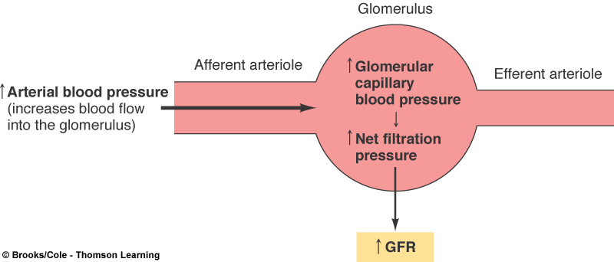
Glomerular Filtration Rate (GFR)
Glomerular Filtration Rate (GFR): the total amount of filtrate formed per minute by the kidneys
GFR regulation is mainly due to changes in the glomerular capillary blood pressure; a higher arterial blood pressure supplying the glomerulus can increase the GFR.

Slide 19
Regulation of GFR
Changes in the GFR primarily result from changes in glomerular capillary blood pressure. Changes in plasma colloid osmotic pressure and Bowman’s capsule hydrostatic pressure are not subject to regulation and do not vary much.
Uncontrolled shifts in the GFR can lead to fluid and electrolyte imbalances.
Three basic mechanisms to keep relatively constant GFR despite changing mean arterial pressure
Autoregulation
Tubuloglomerular feedback mechanism
Hormones & ANS.

Slide 20
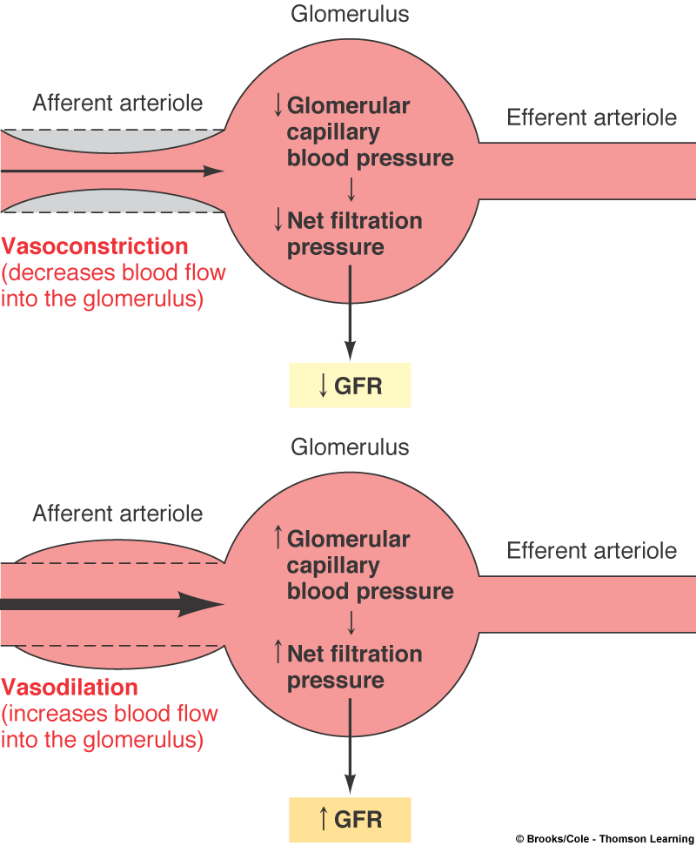
Regulation of GFR
Autoregulation; myogenic, altering the caliber of the afferent arterioles due to stretch.
If the GFR rises by increased arterial pressure, the afferent arterioles constrict. This lowers the GFR.
If the GFR decreases, the afferent arterioles dilate. This increases the GFR.

Slide 21
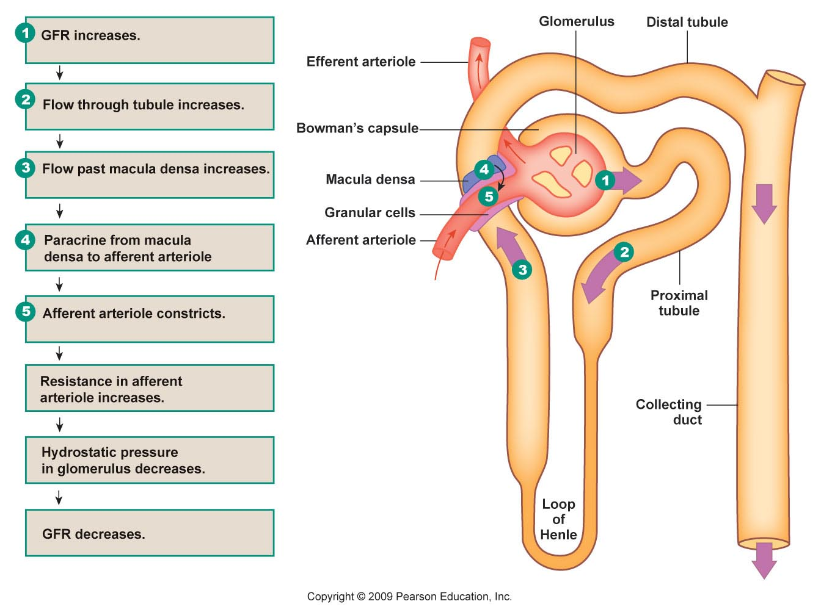
Regulation of GFR
Tubuloglomerular feedback mechanism. sensing changes in flow in the nephron’s tubular component.
The cells of the macula densa monitor NaCl concentration in the fluid moving into the distal convoluted tubule.
If GFR increases, then NaCl movement also increases
Macula densa cells send a paracrine message causing the afferent arteriole to contract, decreasing GFR and NaCl movement

Slide 22
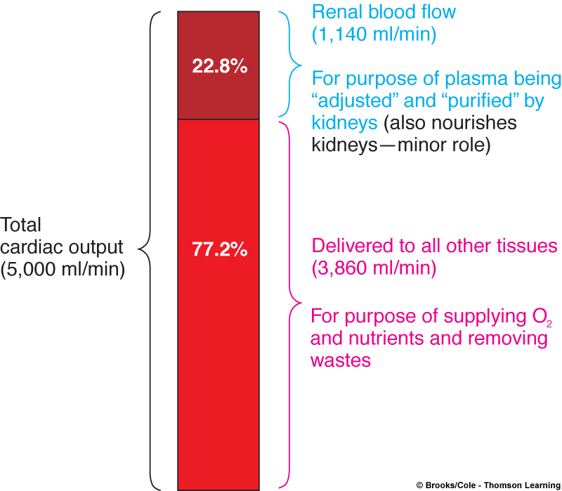
Regulation of GFR
Hormones & ANS
Changing the filtration coefficient
Angiotensin II (vasoconstrictor, released via renin system)
Prostaglandins (Vasodilators)
These hormones may also change the configuration of the filtration slits, altering the filtration coefficient
Changing arteriole resistance
Sympathetic innervation to afferent arterioles, causing vasoconstriction
Stimulated when blood pressure drops to reduce GFR and conserve fluid volume.
Sympathetic nervous system plays an important role on adjusting glomerular blood flow, while parasympathetic nervous system does not have any influence on the kidneys.

Slide 23
Tubular Reabsorption

Slide 24
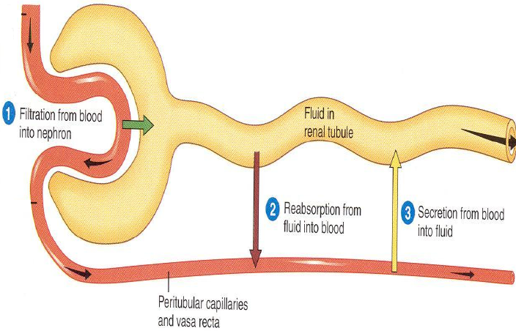
Tubular Reabsorption
Filtered substances are transferred from the tubular lumen to the peritubular capillaries
This process is highly selective and variable.
The return of substances to the blood is needed to maintain the composition of the ECF. Only excesses of materials are eliminated.
Reabsorption rates are high: 124 of 125 ml of filtered fluid per minute,
99% for water
100% for glucose
99.5% for salt.

Slide 25
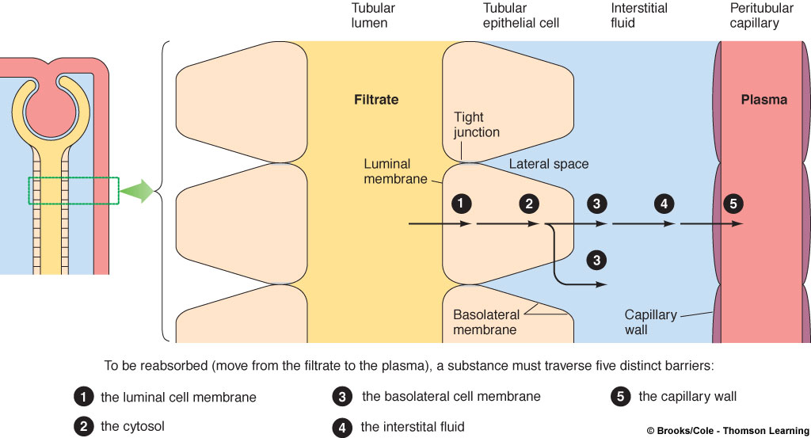
Tubular reabsorption involves transepithelial transport
Reabsorbed substance must cross:
tubule wall
interstitial fluid,
wall of the peritubular capillaries thus entering the blood.
The single layer of epithelial cells of the nephron tubule has:
luminal membrane (facing tubule lumen)
basolateral membrane (facing the interstitial spaces between the tubule and peritubular capillaries)
Ways of reabsorption:
Passive (down electrochemical/osmotic gradients)
Active, requiring energy (against electrochemical/osmotic gradients).

Slide 26
Reabsorption of Na⁺
Of the Na+ filtered, 99.5% is normally reabsorbed.
Sodium is reabsorbed throughout the tubule with the exception of the descending limb of the loop of Henle
Of the Na+ reabsorbed, on average
67% in the proximal tubule (Plays an important role in the reabsorption of glucose, amino acids, water, chloride ions, and urea)
25% in the loop of Henle (Plays a role in the production of varying concentrations and volumes of the urine)
8% in the distal and collecting tubules (depends on hormonal control, and plays an important role in regulating ECF volume).
Aldosterone (stimulated via renin system) increases Na+ reabsorption
Atrial Natriuretic Peptide “ANP” (released from heart) decreases Na+ reabsorption

Slide 27
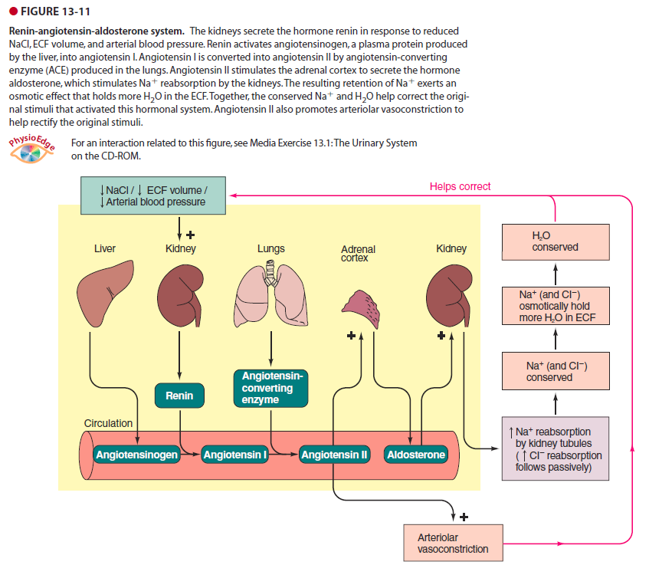

Slide 28
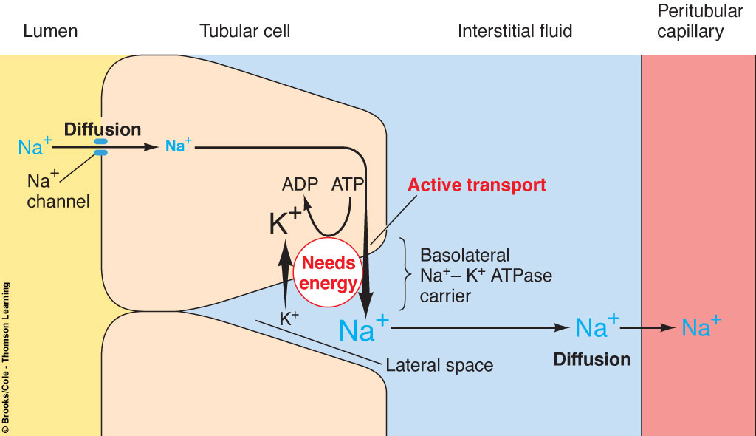
Reabsorption of Na⁺
Involves a Na-K ion ATPase carrier in the tubular cell’s basolateral membrane
This pump keeps sodium concentration low in the tubular cells and high in the lateral spaces outside the tubule.
Water follows reabsorbed sodium by osmosis. Thus, sodium reabsorption has a main effect on blood volume and blood pressure.
Aldosterone promotes Na+ retention by insertion of additional Na+ channels into the luminal membrane, and additional Na+/K+ ATPase into the basolateral membrane of the distal and collecting tubules.
+
Aldosterone
+

Slide 29
Reabsorption of water
Water is passively reabsorbed throughout the length of the tubule as H2O osmotically follows Na+ that is actively reabsorbed.
Water passes through water channels (Aquaporins)
In the proximal tubule → always open
In the distal tubule → regulated by Vasopressin (ADH).
Unwanted waste products (such as phenol and creatinine) are nor reabsorbed.
Glucose and amino acids are absorbed by Na+ dependent secondary active transport.

Slide 30
Tubular Secretion

Slide 31
Tubular secretion is the transfer of substances from the peritubular capillaries into the tubular lumen
The distal parts of the nephron can secrete either potassium or hydrogen ions in exchange for reabsorbed sodium.
Regulating potassium in the ECF is important for membrane excitability. A rise in potassium in ECF can depolarize nerve and muscle cell membranes.
Secretion and removal of H+ from the blood to oppose acidosis
The secretion of organic anions and cations helps eliminate foreign compounds. For example, some of these anions are bound to plasma proteins and cannot be filtered (prostaglandins, histamine, and norepinephrine). Tubular secretion eliminates them from them from the body.
Foreign compounds eliminated by tubular secretion include food additives.

Slide 32
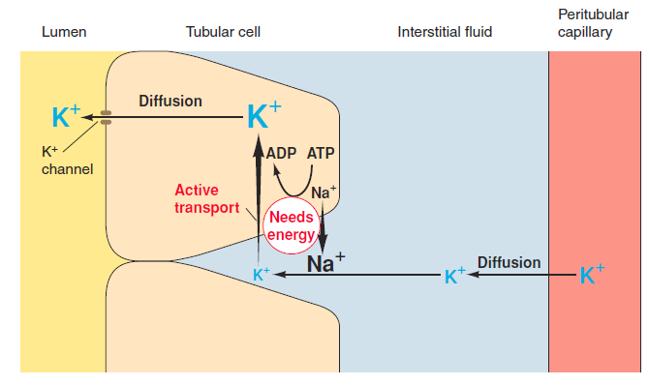
Tubular Secretion of K⁺
K+ is almost completely reabsorbed in the proximal tubule through leaky K+ channels on the basolateral membrane.
K+ is secreted later in the distal tubule and collecting duct. It is variable and subject to regulation.
As the basolateral pump transports Na+ from the lateral spaces, it pumps K+ into the tubular cells (tubular secretion). Then diffuses to the lumen & remains in the urinary tract for elimination
Aldosterone stimulates the tubular cells to secrete potassium if its plasma level is elevated.

Slide 33
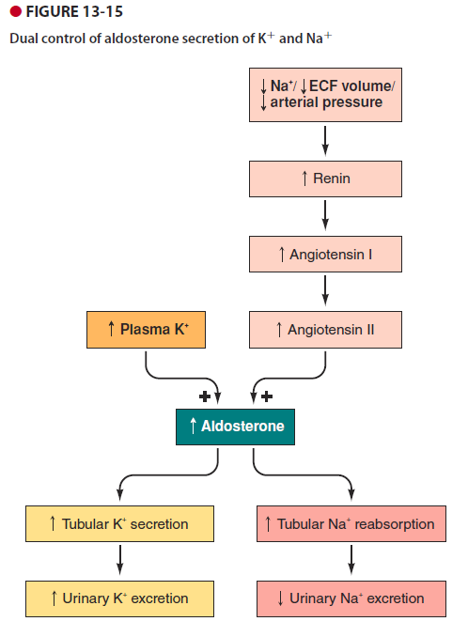

Slide 34
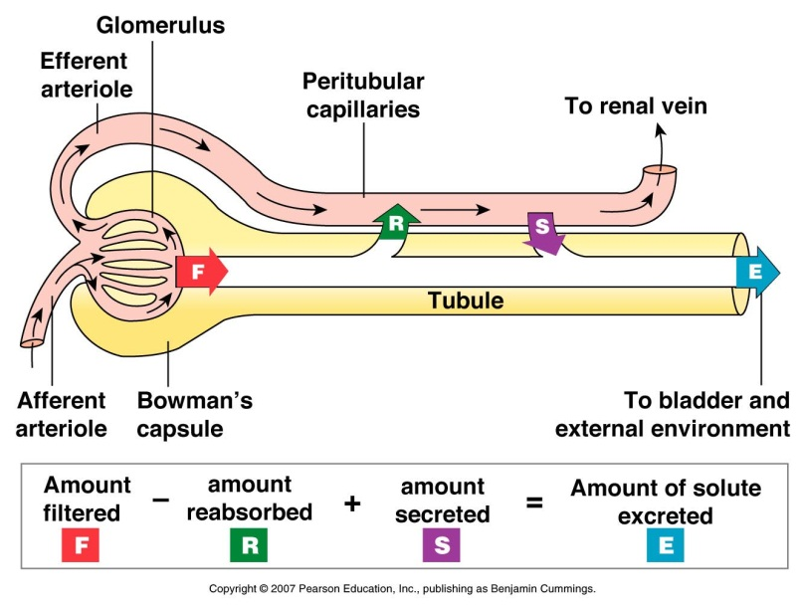
Nephron Excretion & Clearance
Plasma clearance is the volume of plasma cleared of a particular substance per minute
The urinary excretion of substance depends on its filtration, reabsorption, and secretion
Excretion = filtration – reabsorption + secretion

Slide 35
Plasma clearance
If a substance is filtered but not reabsorbed or secreted, its plasma clearance rate equals the GFR.
Inulin is an ideal substance, injected into the body, to compute a clearance rate. Creatine is an endogenous substance that is only filtered.
If a substance is filtered and reabsorbed, but not secreted, its plasma clearance rate is always less than the GFR.
For glucose, it is zero, as the reabsorption of glucose is 100 percent.
For urea, it is 50%.
If a substance is filtered and secreted, but not reabsorbed, its plasma clearance rate is always greater than the GFR
PAH

Slide 36
Concentrated vs. Diluted Urine
Depending on the body’s state of hydration, the kidneys secrete urine of varying concentrations
Too much water in the ECF establishes a hypotonic ECF → diluted urine
A water deficit establishes a hypertonic ECF → concentrated urine
Mechanism: vertical osmotic gradient in the interstitial fluid of the renal medulla

Slide 37
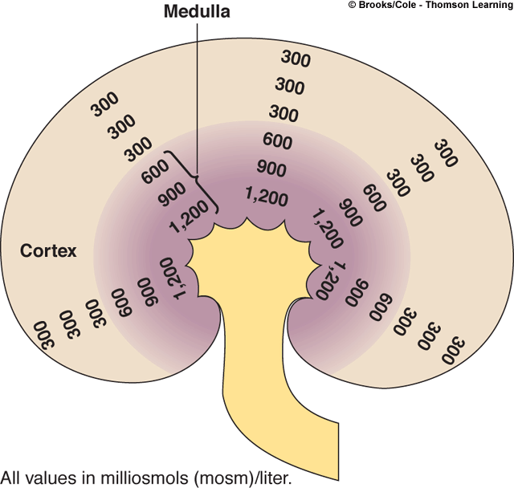
Medullary Vertical Osmotic Gradient
In order to concentrate urine (and prevent a large volume of water from being lost), the kidney must maintain a high concentration of solutes in the medulla
A large, vertical osmotic gradient is established in the interstitial fluid of the medulla (from 100 to 1200 mosm/liter). This increase follows the hairpin loop of Henle deeper and deeper into the medulla.
This osmotic gradient exists between the tubular lumen and the surrounding interstitial fluid.
The medullary vertical osmotic gradient is generated via countercurrent multiplication

Slide 38
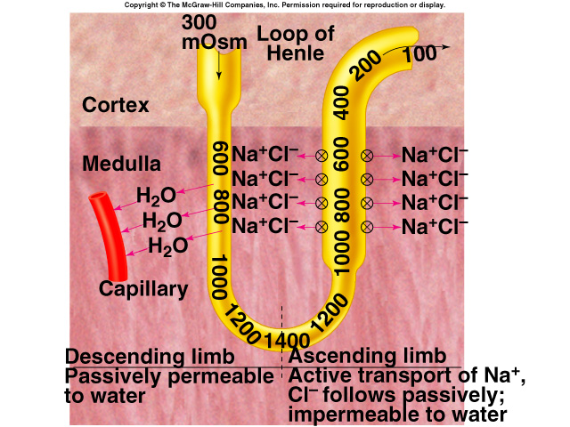
Countercurrent Multiplication
Ascending limb: Impermeable to H₂O/Permeable to salt
Descending Limb: permeable to H₂O/impermeable to salt
Salt pumping in thick ascending part raises osmolarity around descending limb, causing more H₂0 to diffuse out of filtrate
H₂0 diffuses out of filtrate until it equilibrates with interstitial fluid
This H20 is reabsorbed by capillaries
Urea contributes to high osmolality in medulla
Deep region of collecting duct is permeable to urea & transports it

Slide 39
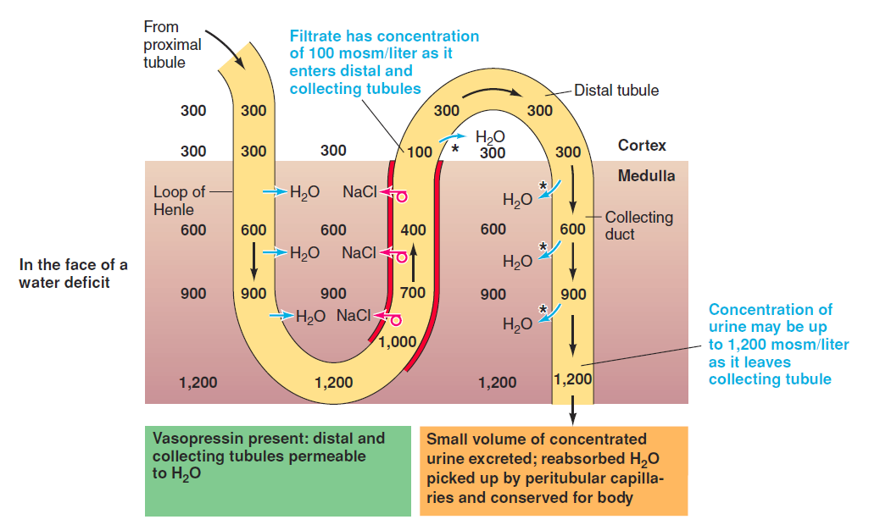

Slide 40
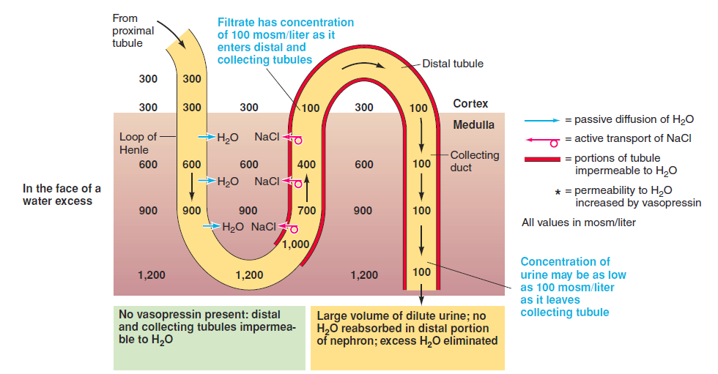

Slide 41
Urine Concentration & Dilution
Urine normally exits the nephron in a dilute state, however under hormonal controls, water reabsorption occurs and can create an extremely concentrated urine.
Aldosterone & ADH are the two main hormones that drive this water reabsorption
Aldosterone
Increases Na+/K+ ATPase activity and therefore reabsorption of Na+… (water follows by osmosis)
ADH (Vasopressin)
Opens up water channels in the collecting duct, allowing for the reabsorption of water

Slide 42
Micturition
Once excreted, urine travels via the paired ureters to the urinary bladder where it is held (about ½ L)
Sphincters control movement out of the bladder
Internal sphincter – smooth muscle (involuntary)
External sphincter – skeletal muscle (voluntary)

Slide 43
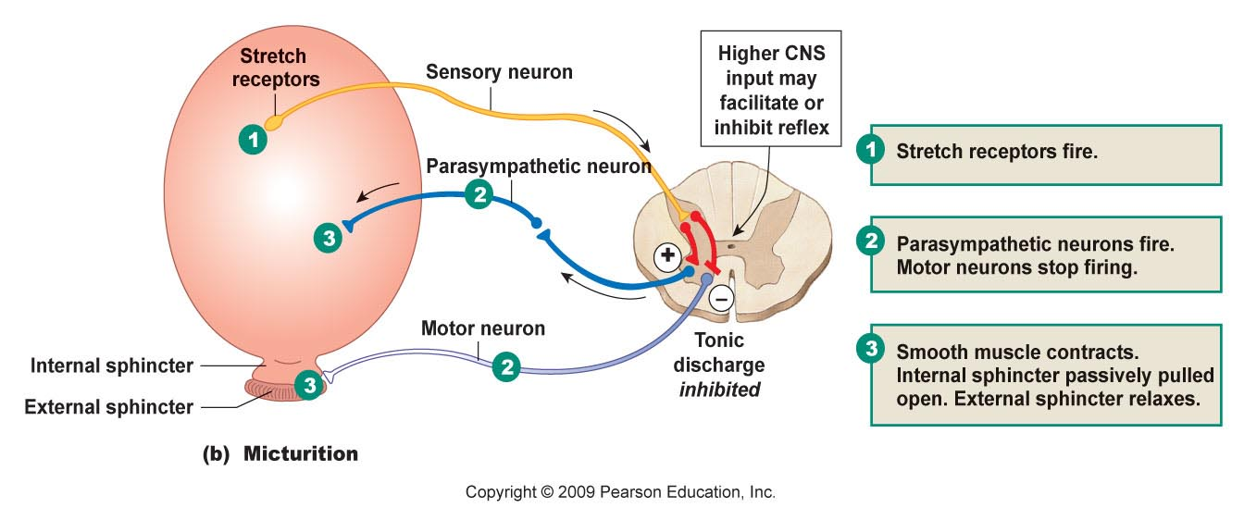
Micturition
Reflex Pathway

Slide 44
The End

