Slide 1
Unit 16
Feeding Patients: Hospital Food and Enteral and Parenteral Nutrition
Dr. Banan T. Awawdeh

Slide 2
Objectives
Components of standard and texture-modified hospital diets and indications.
Malnutrition.
TPN.

Slide 3
A variety of normal and therapeutic diets are prescribed in acute and long-term care.
The diet based upon a client’s nutritional or physical needs.
A Regular or House diet does not restrict intake of any nutrient, food group, or consistency of food.

Slide 4
Clear Liquids diet
oral hydration
bowel preparation for procedures
transitioning the client to solid foods from NPO (Nil per os a medical instruction meaning to withhold oral food and fluids from a patient for various reasons. It is a Latin phrase )

Slide 5
Clear liquids should not be used as the sole source of nutrition for more than 72 hours because of inadequate nutrients and energy levels.
liquid at room temperature:
clear juices—cranberry, apple, grape.
clear drinks—fruit punch, sodas plain tea, black coffee
Gelatin
honey

Slide 6
The Full Liquids diet for clients with chewing or swallowing difficulties.
High lactose, high fat, and low fiber content make this inappropriate for prolonged use.
Foods liquid at room temperature:
juices
dairy or dairy alternative—beverages, ice cream, yogurt
custard, pudding
hot cereal
liquid oral nutrition supplements

Slide 7
Interventions for the hospitalized patient with malnutrition.
Malnutrition occurs in the hospital at a surprisingly significant rate; up to 50% of adults in health care institutions have protein-calorie malnutrition
Malnutrition that occurs because of health care practices or treatment is called iatrogenic malnutrition.
prolonged use of clear liquid diets
missed or interrupted meals or tube feedings because of medical testing or procedures
treatment and medication side effects that diminish appetite
lack of adequate feeding assistance

Slide 8
Malnutrition screening upon admission is the nurse’s assessment to provide a basis for monitoring client nutrition status while hospitalized.
diseases that affect nutrient absorption or metabolism
preoperative fasting practices

Slide 9
The client’s well-being becomes jeopardized with increased:
length of stay
costs
infection rates
disease complications
poor wound healing
altered pharmacokinetics
increased mortality rates

Slide 10
Treatment requires collaboration of all health care professionals and addressing interventions that target the cause.
determined by the etiology of condition
optimizing intake to compensate for decreased intake, malabsorption, nutrient losses, or unmet increased needs
Clients with poor appetites should be encouraged to consume foods with higher nutrient content at the start of the meal to avoid filling up on foods with little nutritional value.
Offering nutrient-dense meals and snacks frequently is helpful for those who get full too quickly, a condition called early satiety.
Proper feeding assistance is crucial in clients who are unable to self-feed.

Slide 11
Enteral nutrition—nutrition support that utilizes the GI tract
Parenteral nutrition—intravenous nutrition when the GI tract is not functioning

Slide 12
Enteral nutrition
liquid nutrition supplements
feeding tubes
Enteral nutrition: A way to provide food through a tube placed in the nose, the stomach, or the small intestine. A tube in the nose is called a nasogastric tube.

Slide 13
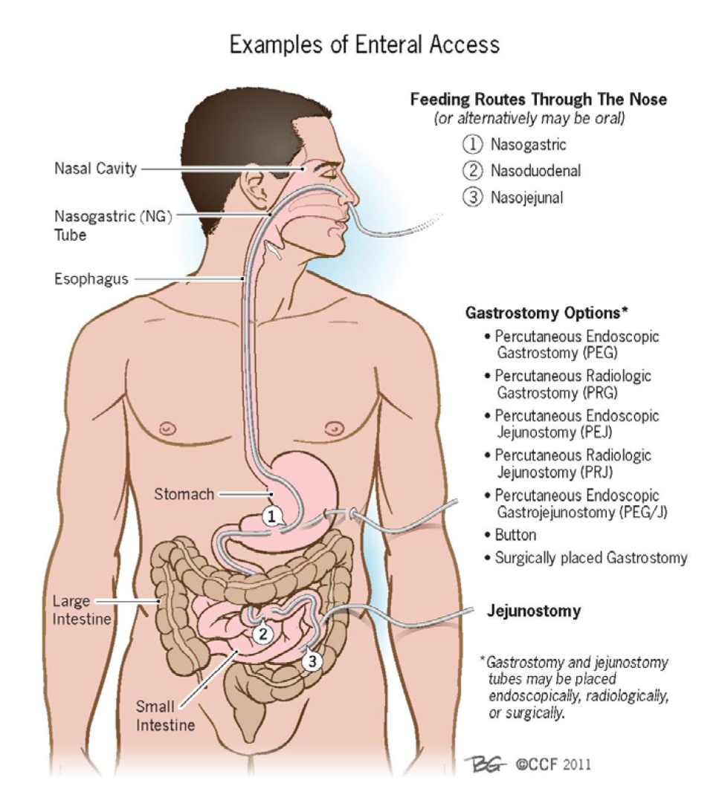

Slide 14
Enteral nutrition
Enteral nutrition:
support involves the use of oral liquid nutrition supplements or tube feedings.
Tube feeding is indicated in clients who cannot safely take adequate oral nutrition.
Examples include:
1. those at risk of aspirating oral intake.
2. who are unconscious.
3. experiencing significant anorexia.
4.unable to consume adequate intake to match increased metabolic demands.

Slide 15
Cont………..
Enteral nutrition formulas are available in an array of nutrient mixes and forms.
1. polymeric formulas
2. elemental formulas
3. modular formulas

Slide 16
polymeric formulas—an intact macronutrient rich formula, recommended for clients with full digestive and absorptive function (requires GI enzymes and secretions to function)
ex. soy protein, milk proteins; casein and whey

Slide 17
. elemental formulas—predigested macronutrient formulas, recommended for clients with limited GI enzyme secretion and absorptive function
ex. proteins broken down to amino acids and simple sugars

Slide 18
modular formulas—contains just a protein, fat, or carbohydrate source to mix with polymeric and elemental formulas to increase nutrient content; also used for disease-specific use with recommendations for feeding certain diagnoses
ex. respiratory clients need higher fat formulas enriched with certain amino acids (glutamine) to benefit the client during physiological stress

Slide 19
Proper feeding techniques:
client positioning
medication administration
delivery of the prescribed volume
requires diligent monitoring

Slide 20
Parenteral nutrition
Parenteral nutrition is indicated when a client requires specialized nutrition support and the gastrointestinal tract is not functioning.
paralytic ileus—intestinal obstruction, bowel ischemia, lack of gut peristalsis
short bowel syndrome—loss of significant absorptive surface

Slide 21
The macronutrient content of parenteral nutrition must be in the most basic form since the solution bypasses the digestive and absorptive processes and is infused directly into the bloodstream.
The route and rate of solution delivery depends on the condition and needs of the client.
by some route other than through the alimentary canal, such as by subcutaneous, intramuscular, intrasternal, or intravenous injection.

Slide 22
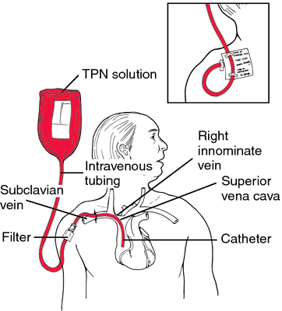

Slide 23
Peripheral parenteral:
nutrition via a peripheral vein where the need for nutrition support is short term and the client is able to handle the fluid volume of the solution.
Total parenteral:
Nutrition will be needed for more than ten days, or the patient is fluid restricted; utilizes a central vein.

Slide 24
Parenteral nutrition:
carbohydrates = dextrose
protein = amino acids
lipids = essential fatty acids
vitamins
minerals
electrolytes

Slide 25
Palliative nutrition
Palliative nutrition, or nutrition meant to aid in relief of symptoms or discomfort rather than cure.
Providing oral hydration and nutrition can be implemented to client tolerance.
Thirst can be alleviated with liquids as tolerated, ice chips, mouth care, and lubricating the lips.
When dehydration and its metabolic consequences occur, a sedative effect results along with reduction in oral secretions, urination, and bronchial congestion—all of which may lessen patient suffering.
In cases such as when the client is terminally ill or has advanced dementia, the health care team and the client or proxy should evaluate nonoral feeding, whether by feeding tube or parenteral route.

Slide 26
Respecting cultural and religious beliefs during end-of-life treatments
difficult process to be involved in decision-making regarding the withholding of nutrition support
an understanding of the ethical, legal, medical, and personal components contributing to decisions is essential for the nurse involved in end-of-life care

Slide 27
THE END…… …..questions????

