Slide 1
Chapter 58 Assessment and Management of Patients With Eye and Vision Disorders

Slide 2
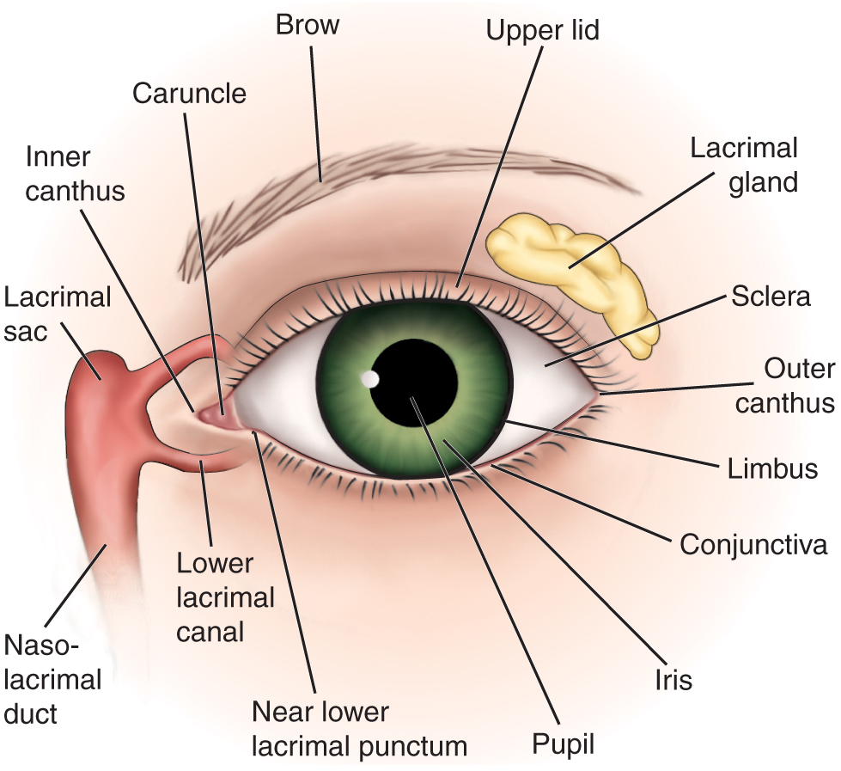
External Structures of the Eye

Slide 3
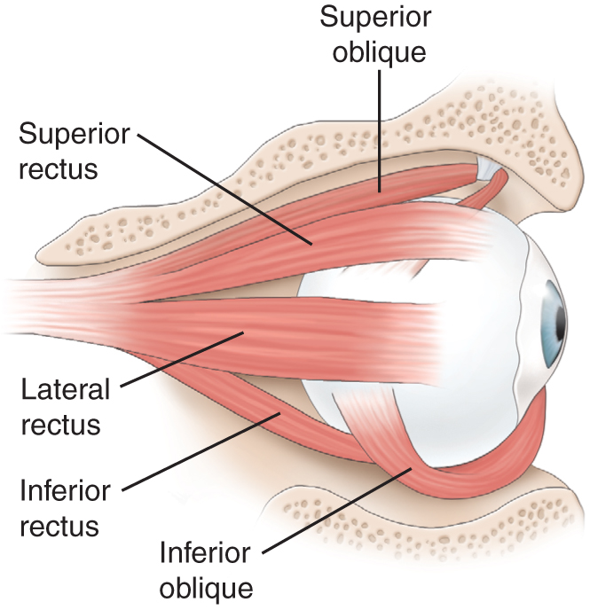
Extraocular Muscles

Slide 4
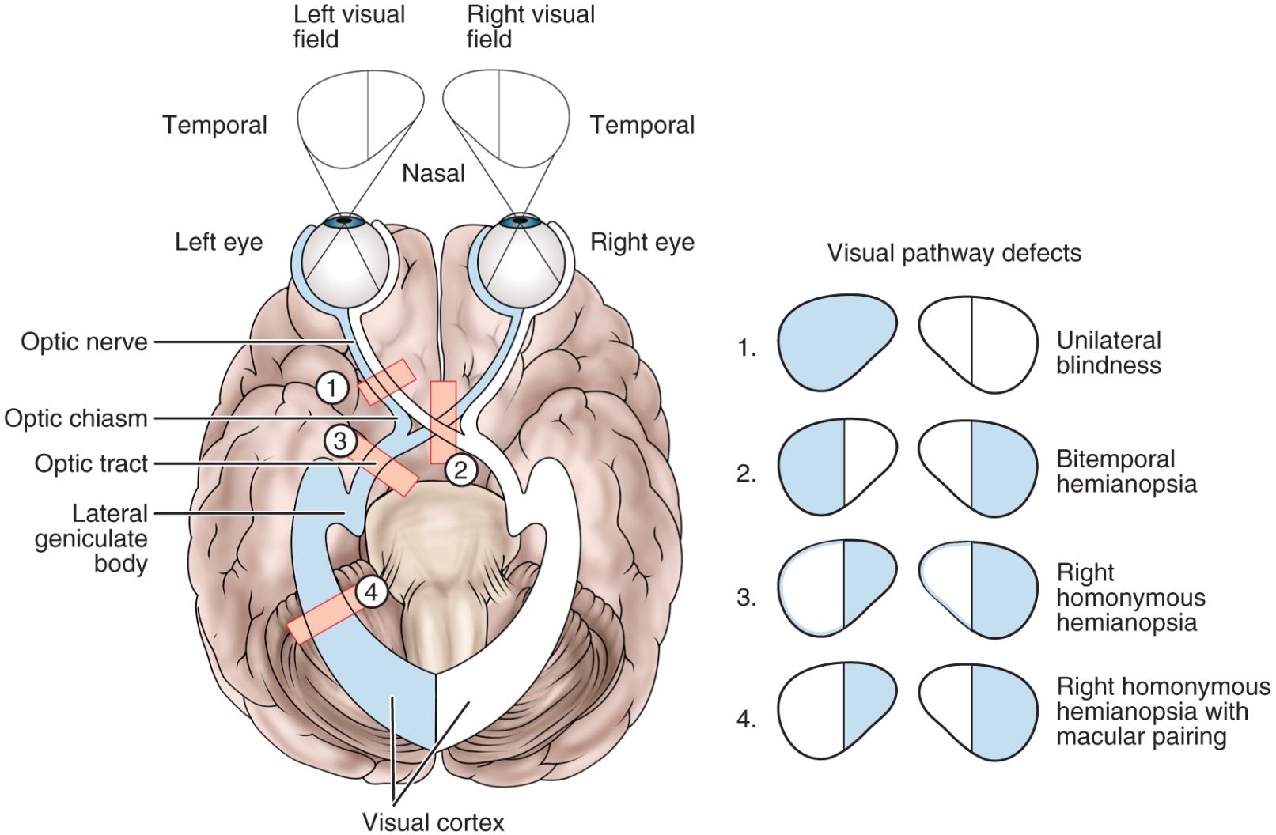
Visual Pathways

Slide 5
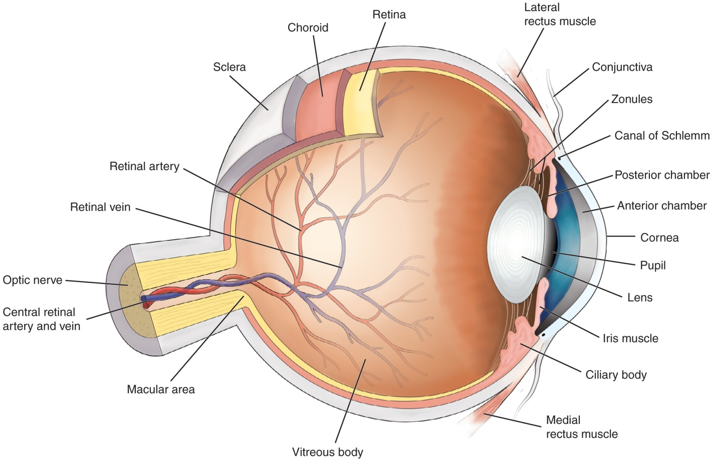
Cross-Section of the Eye

Slide 6
Internal Structures of the Eye
Refer to fig. 58-4

Slide 7
Assessment and Evaluation of Vision
Ocular history
Visual acuity
Snellen chart
Record each eye
20/20 means the patient can read the “20” line at a distance of 20 feet
Finger count or hand motion

Slide 8
Examination of the External Structures
Note any evidence of irritation, inflammatory process, discharge, etc.
Assess eyelids and sclera
Assess pupils and pupillary response; use darkened room
Note gaze and position of eyes
Assess extraocular movements
Ptosis: drooping eyelid
Nystagmus: oscillating movement of eyeball

Slide 9
Diagnostic Evaluation
Ophthalmoscopy
Direct and indirect
Examines the cornea, lens and retina
Slit-lamp examination
Color vision testing
Amsler grid
Ultrasonography
Fluorescein and indocyanine green angiography

Slide 10
Diagnostic Evaluation
Tonometry
Measures intraocular pressure
Gonioscopy
Visualizes the angle of the anterior chamber
Perimetry testing
Evaluates field of vision
Scotomas: blind areas in the visual field

Slide 11
Impaired Vision
Refractive errors
Can be corrected by lenses which focus light rays on the retina
Emmetropia: normal vision
Myopia: nearsighted
Hyperopia: farsighted
Astigmatism: distortion due to irregularity of the cornea

Slide 12
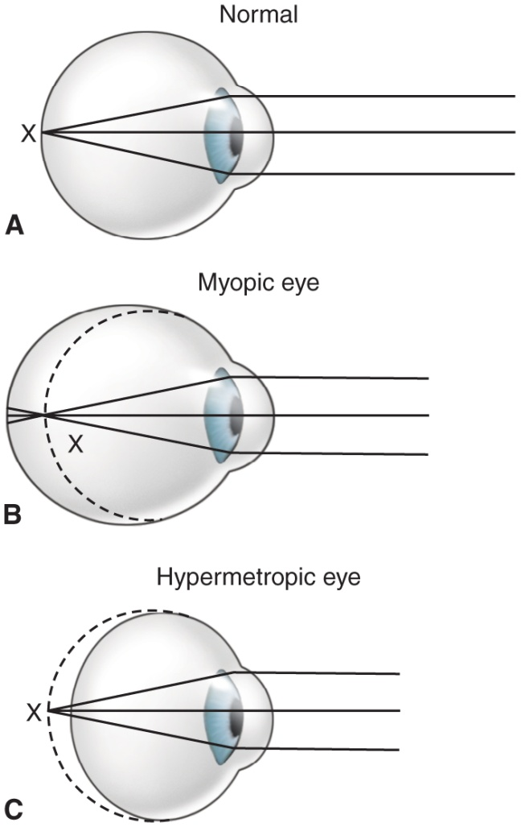
Eyeball shape determines visual acuity in refractive errors

Slide 13
Glaucoma
A group of ocular conditions in which damage to the optic nerve is related to increased intraocular pressure (IOP) caused by congestion of the aqueous humor
The leading cause of blindness in adults in the U.S.
Incidence increases with age
Risk factors

Slide 14
Pathophysiology of Glaucoma
Normal Outflow of Aqueous Humor
Refer to fig. 58-7
In glaucoma, aqueous production and drainage are not in balance.
When aqueous outflow is blocked, pressure builds up in the eye.
Increased IOP causes irreversible mechanical and/or ischemic damage.

Slide 15
Types of Glaucoma
Open-angle
Angle-closure (pupillary block) glaucoma
Congenital glaucomas and glaucoma secondary to other conditions

Slide 16
Clinical Manifestations
“Silent thief”; unaware of the condition until there is significant vision loss; peripheral vision loss, blurring, halos, difficulty focusing, difficulty adjusting eyes to low lighting
May also have aching or discomfort around eyes or headache

Slide 17
Diagnostic Findings
Tonometry to assess IOP
Gonioscopy to assess the angle of the anterior chamber
Perimetry to assess vision loss
Progression of visual field defects
Refer to fig. 58.8

Slide 18
Treatment
Goal is to prevent further optic nerve damage
Maintain IOP within a range unlikely to cause damage
Pharmacologic therapy
Surgery
Laser tribeculoplasty
Laser iridotomy
Filtering procedures
Tribeculectomy
Drainage implants or shunts

Slide 19
Treatment
Laser trabeculoplasty uses a very focused beam of light to treat the drainage angle of the eye
Laser iridotomy uses a very focused beam of light to create a hole on the outer edge, or rim, of the iris
trabeculotomy are similar simple and directed techniques of microsurgical dissection with mechanical disruption of the trabecular meshwork

Slide 20
Nursing Management
Patient education.
Focus on maintaining the therapeutic regimen for lifelong control of a chronic condition.
Emphasize the need for adherence to therapy and continued care to prevent further vision loss.
Provide education regarding use and effects of medications.
Medications used for glaucoma may cause vision alterations and other side effects. The action and effects of medications need to be explained to promote compliance.
Provide support and interventions to aid the patient in adjusting to vision loss/potential vision loss.

Slide 21
Cataracts
An opacity or cloudiness of the lens
Increased incidence with aging; by age 80 more than half of all Americans have cataracts
A leading cause of disability in the U.S.
Risk factors

Slide 22
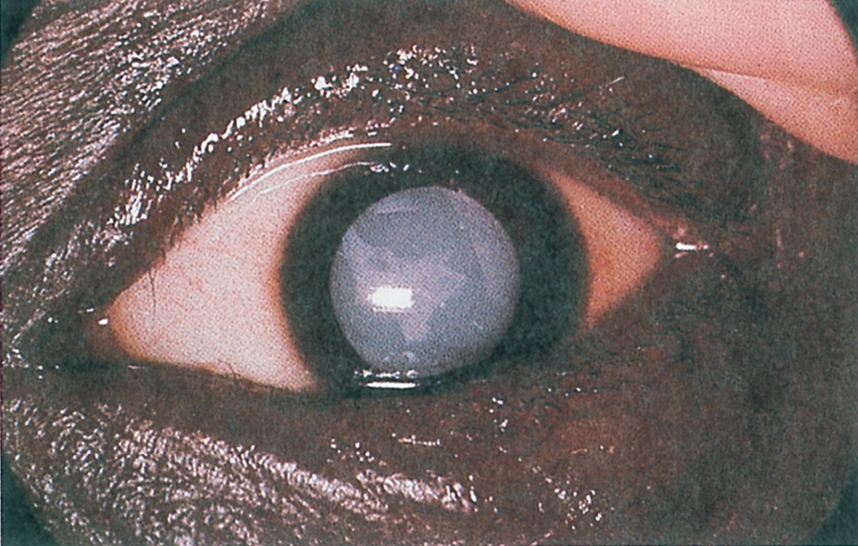
Cataract

Slide 23
Clinical Manifestations
Painless, blurry vision
Sensitivity to glare
Reduced visual acuity
Other effects include myopic shift, astigmatism, diplopia (double vision), and color shifts including brunescens (color value shift to yellow-brown)
Diagnostic findings include decreased visual acuity and opacity of the lens by ophthalmoscope, slit-lamp, or inspection

Slide 24
Surgical Management
If reduced vision does not interfere with normal activities, surgery is not needed.
Surgery is preformed on an outpatient basis with local anesthesia.
Surgery usually takes less than 1 hour and patients are discharged soon afterward.
Complications are rare but may be significant.

Slide 25
Types of Cataract Surgery
Intracapsular cataract extraction (ICCE): removes entire lens, rarely done today
Extracapsular cataract extraction (ECCE): maintains the posterior capsule of the lens, reducing potential postoperative complications
Phacoemuslification: an ECCE which uses an ultrasonic device to suction the lens out through a tube; incision is smaller than with standard ECCE
Lens replacement: after removal of the lens by ICCE or ECCE, the surgeon inserts an intraocular lens implant (IOL). This eliminates the need for aphakic lenses, however, the patient may still require glasses.

Slide 26
Nursing Management
Preoperative care
Usual preoperative care for ambulatory surgery
Dilating eye drops or other medications as ordered
Postoperative care
Patient teaching
Provide written and verbal instructions
Instruct patient to call physician immediately if vision changes; continuous flashing lights appear; redness, swelling, or pain increase; type and amount of drainage increases; or significant pain is not relieved by acetaminophen

Slide 27
Ophthalmic Medications
Ability of the eye to absorb medication is limited.
Barriers to absorption include the size of the conjunctival sac, corneal membrane barriers, blood-ocular barriers, and tearing, blinking, and drainage
Intraocular injection or systemic medication may be needed to treat some eye structures or to provide high concentrations of medication.
Topical medications (drops and ointments) are most frequently used because they are least invasive, have fewest side effects, and permit self administration.

Slide 28
Ophthalmic Medications
Topical anesthetics
Mydriatics (dilate) and cycloplegics (paralyze)
Contraindicated with narrow angles or shallow anterior chambers and inpatients on monoamine oxidase inhibitors or tricyclic antidepressant
May cause CNS symptoms and increased BP especially in children or the elderly
Anti-infective medications
Antibiotic, antifungal, or antiviral products

Slide 29
Ophthalmic Medications
Medications used for glaucoma
Increase aqueous outflow or decrease aqueous production
May constrict the pupil and may affect ability to focus the lens of the eye; affects vision
May also may produce systemic effects
Anti-inflammatory drugs; corticosteroid suspensions
Side effects of long-term topical steroids include glaucoma, cataracts, and increased risk of infection. To avoid these effects, oral NSAID therapy may be used as an alternate to steroid use

Slide 30
Safety Measures and Teaching
Patient teaching is a vital nursing intervention for patient with eye and vision disorders
Prevention of eye injuries; education
Safety strategies for patients with low vision in the hospital and home setting
Patient teaching after eye surgery or trauma
Potential complications
Loss of binocular vision with patch or vision impairment of one eye; safety
Use of eye patch and shield

Slide 31
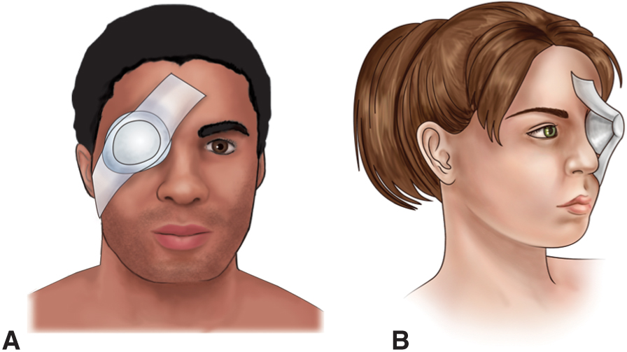
Protective Eye Patches

